Slide 1
HHP Service Learning Honduras 2019

Slide 2
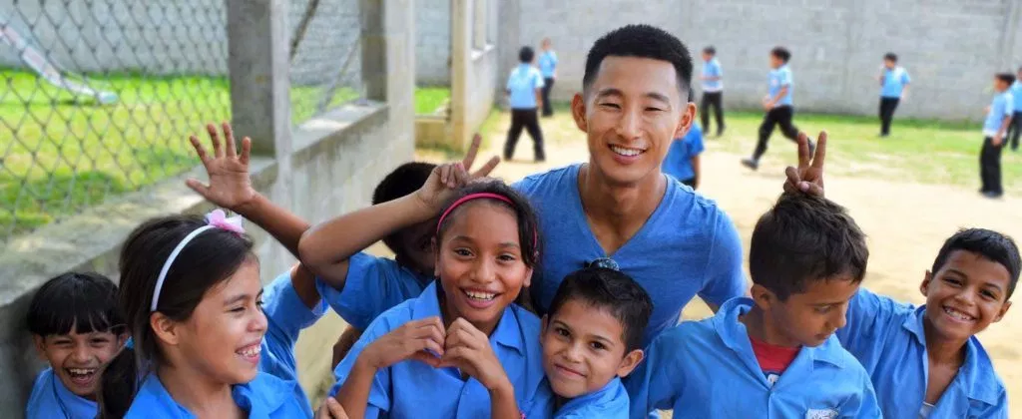
Introduction to Students Helping Honduras
and Founder: Shin Fujiyama (2009 CNN Hero)
Why Honduras?
https://www.youtube.com/watch?v=BFqmzsZiBYk

Slide 3
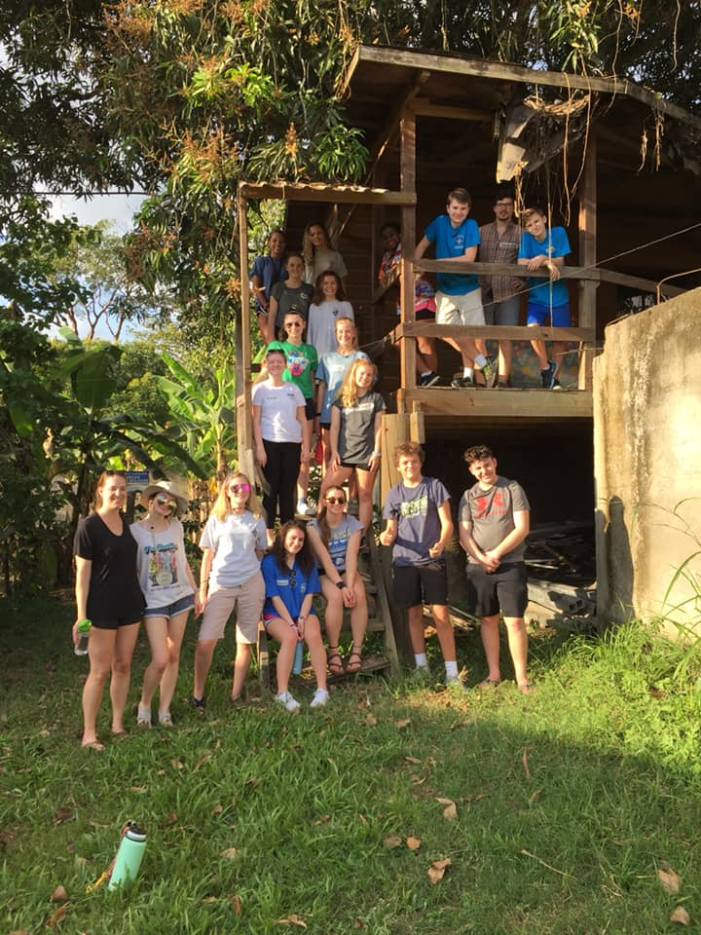
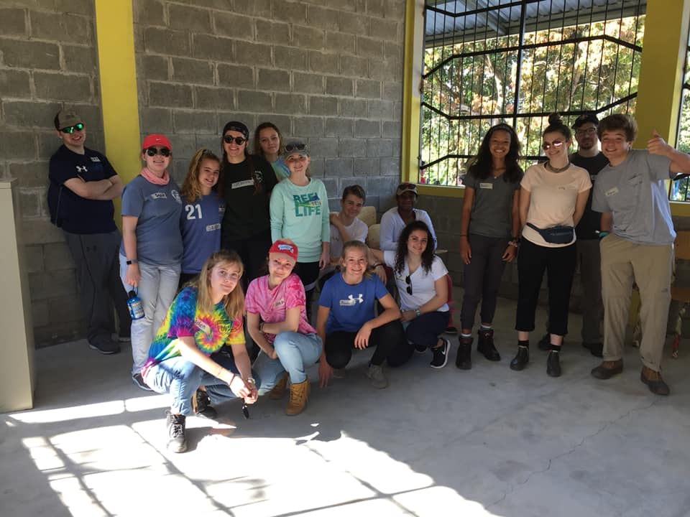

Slide 4
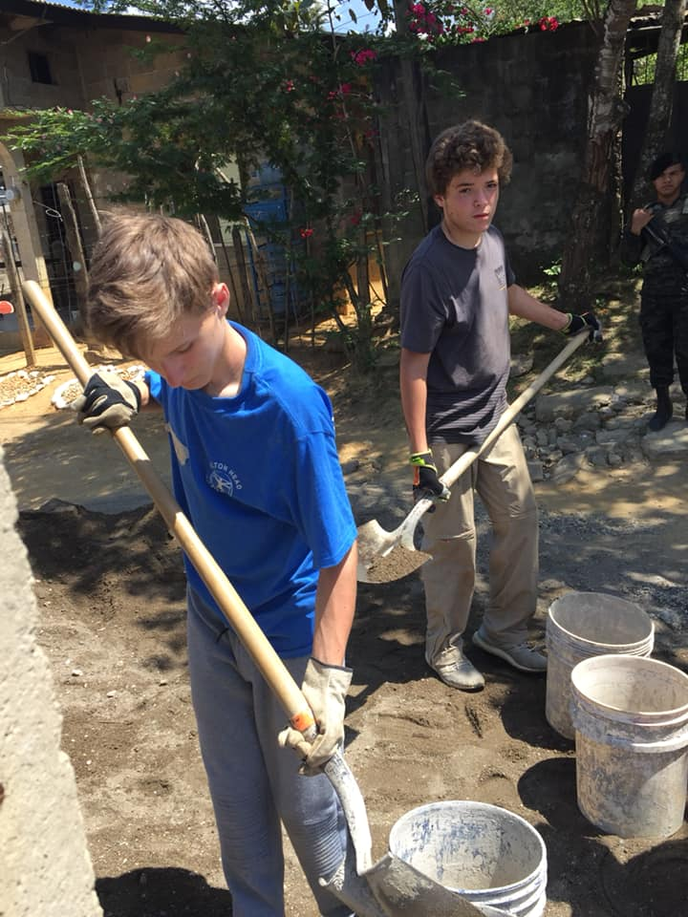
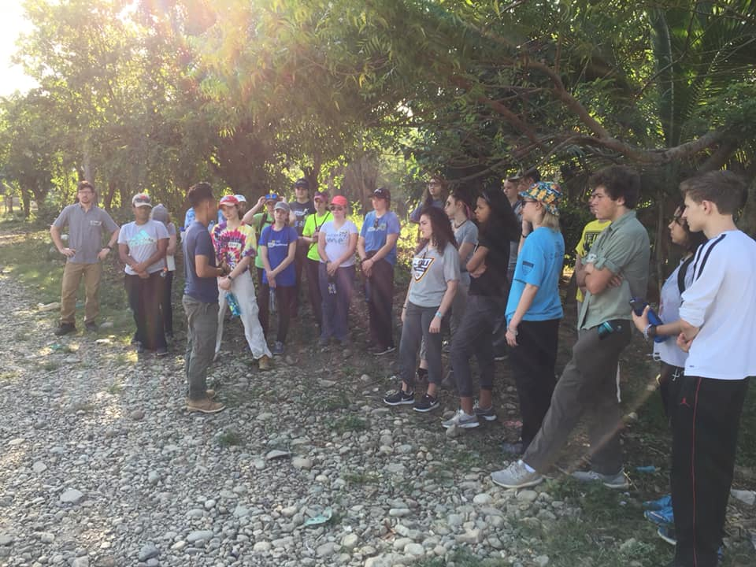
Wyatt and Adam: Villa Soleada Construction

Slide 5
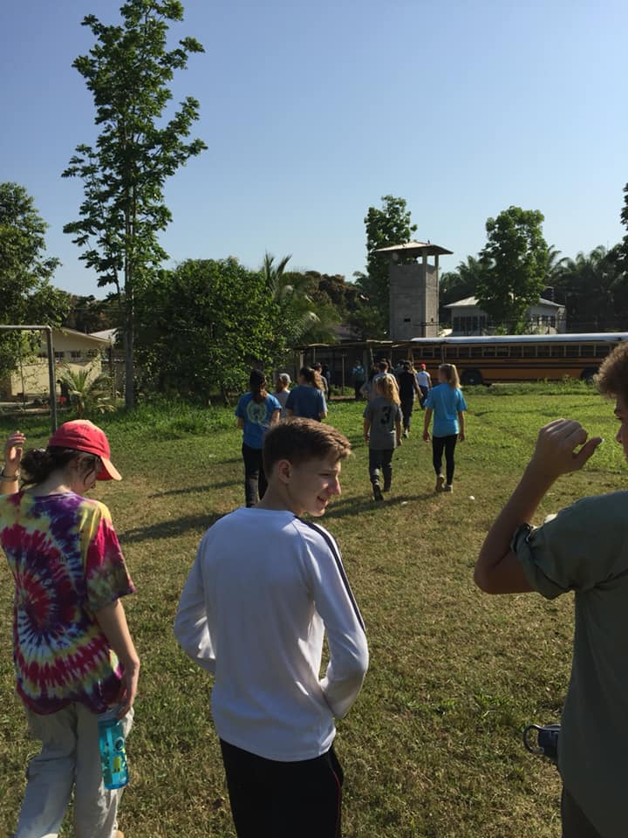
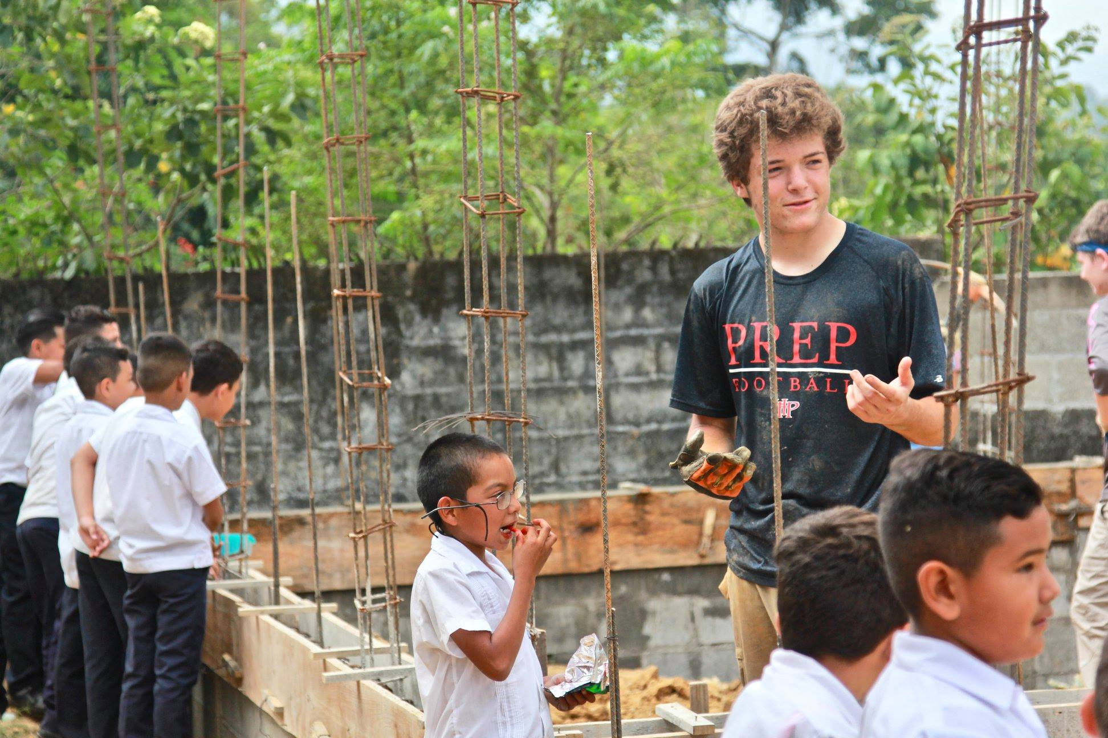

Slide 6
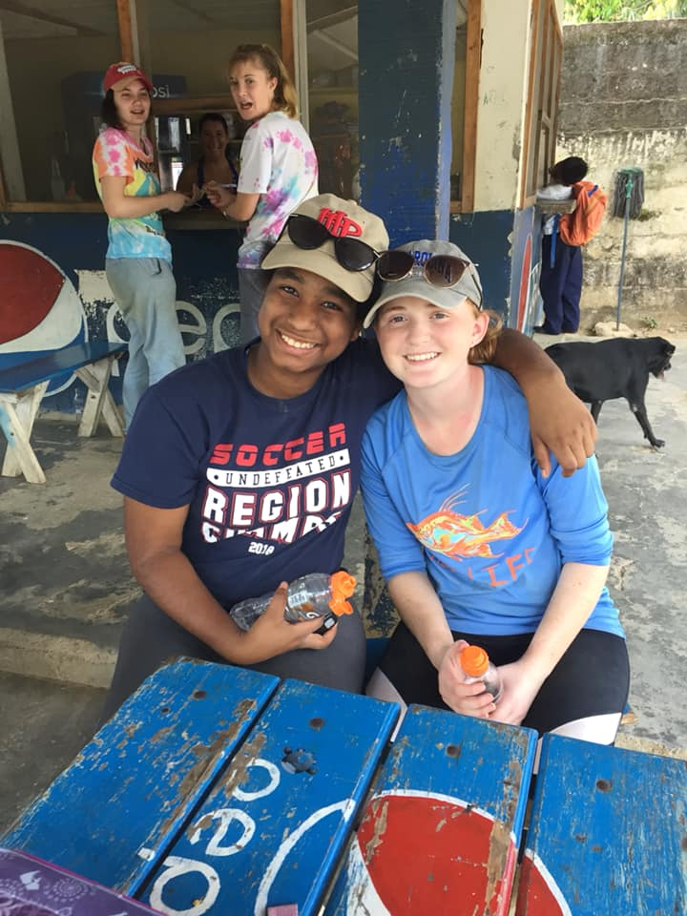
Erika and Tessa: The Bilingual School at Villa Soleada
Honduras has 66% poverty rate and is currently the most unequal country in Latin America
37% of Honduran children ages 12-16 are not in school
A household survey revealed that 0% of residents in the community of Villa Soleada had graduated high school
After a new community was built (what is now known as Villa Soleada) many challenges still remained: generational poverty, illiteracy, chronic unemployment, drug abuse,violent crime and malnutrition. In 2012, the community and SHH decided to begin building one more thing: the bilingual school.
The dream was that one day, every child from the community would be a highschool and college graduate (cradle - career program)

Slide 7
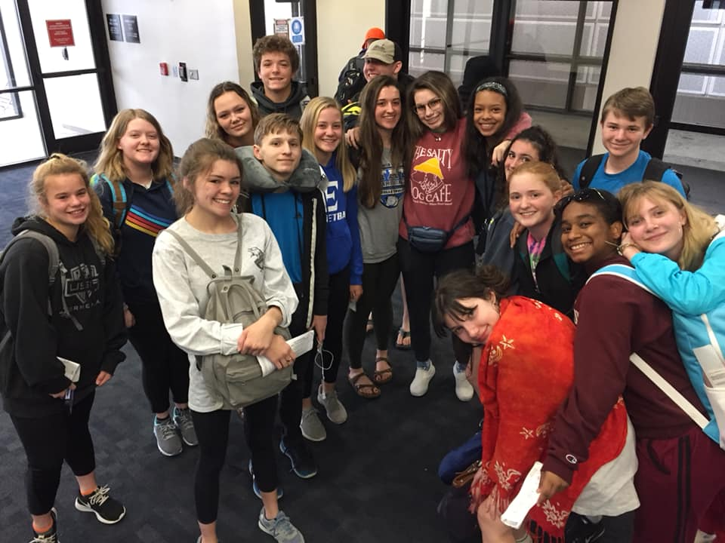
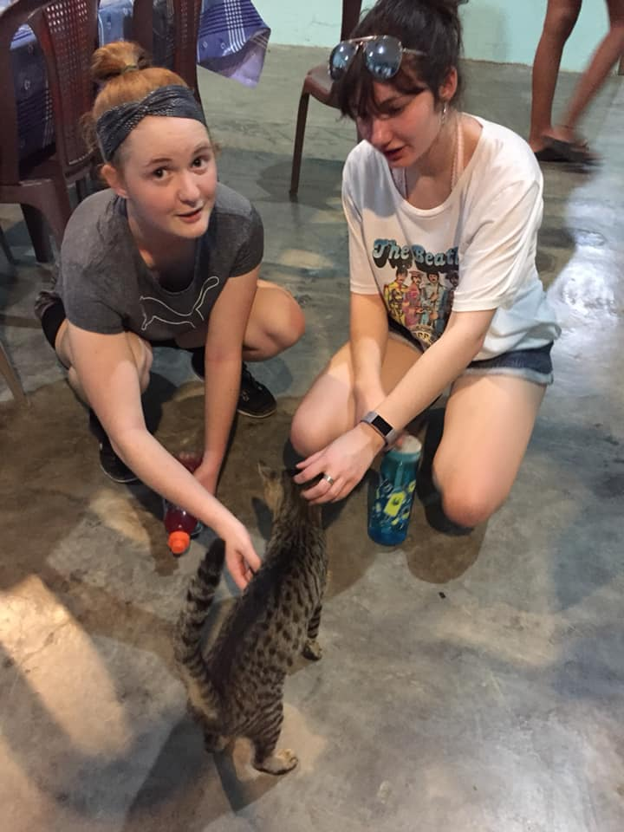
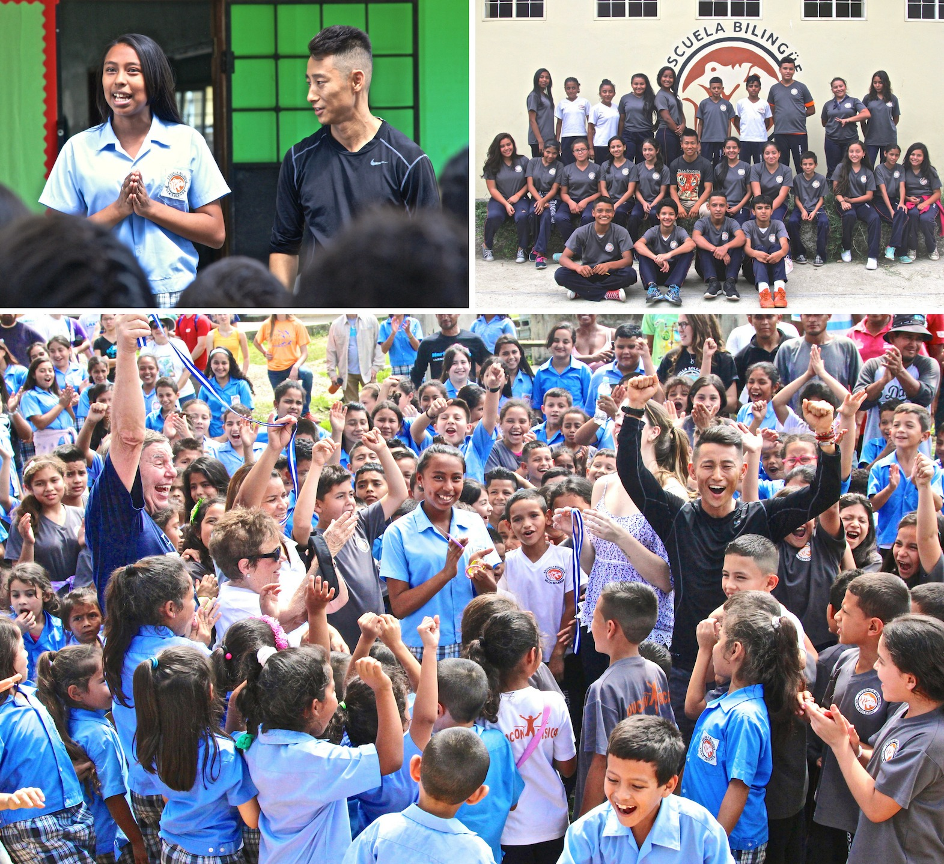
Villa Soleada Bilingual School (continued)
Students from Villa Soleada attend the school on a full scholarship

Slide 8
Susan, Avery, and Sadie: Children at Villa Soleada
After a long day of working on the worksite we come back to villa being greeted by the children and families.
We would have some free time in the afternoon to play with the kids. (we would play soccer, tag ect.)
Alongside building the school we would also create a bond with the kids throughout the community.

Slide 9
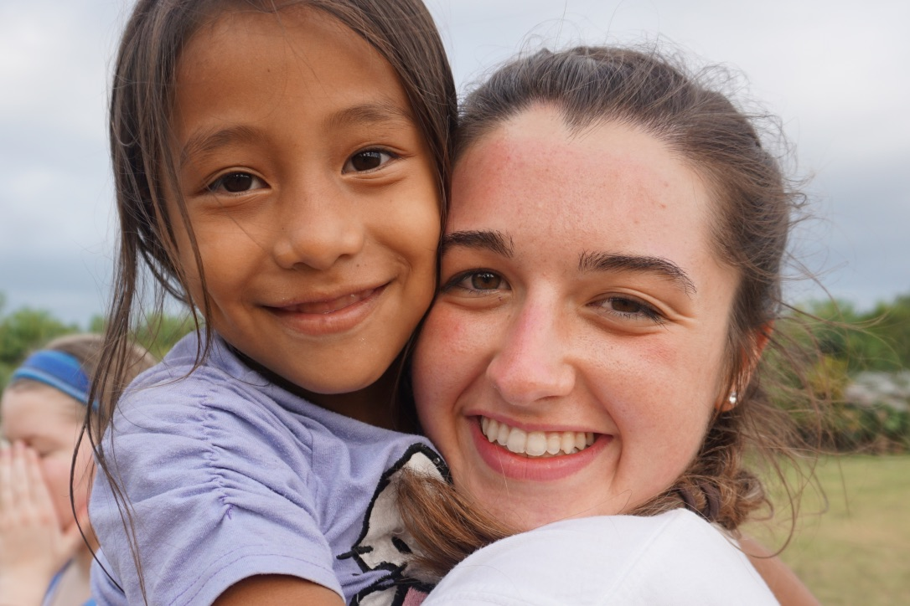
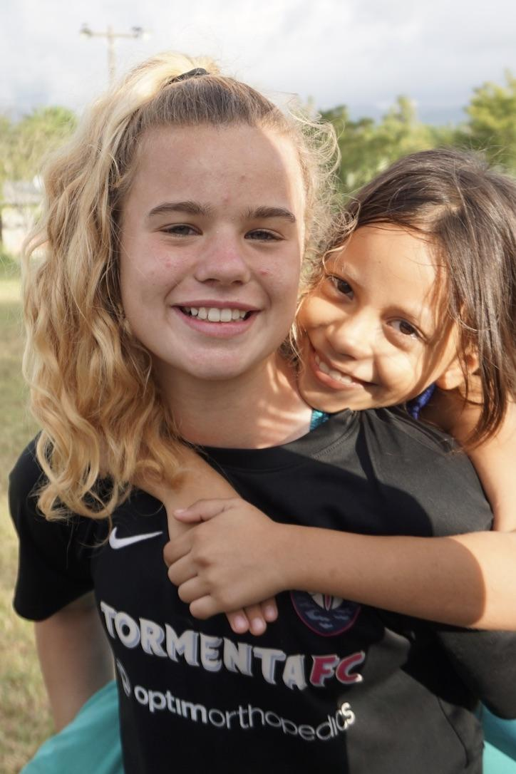
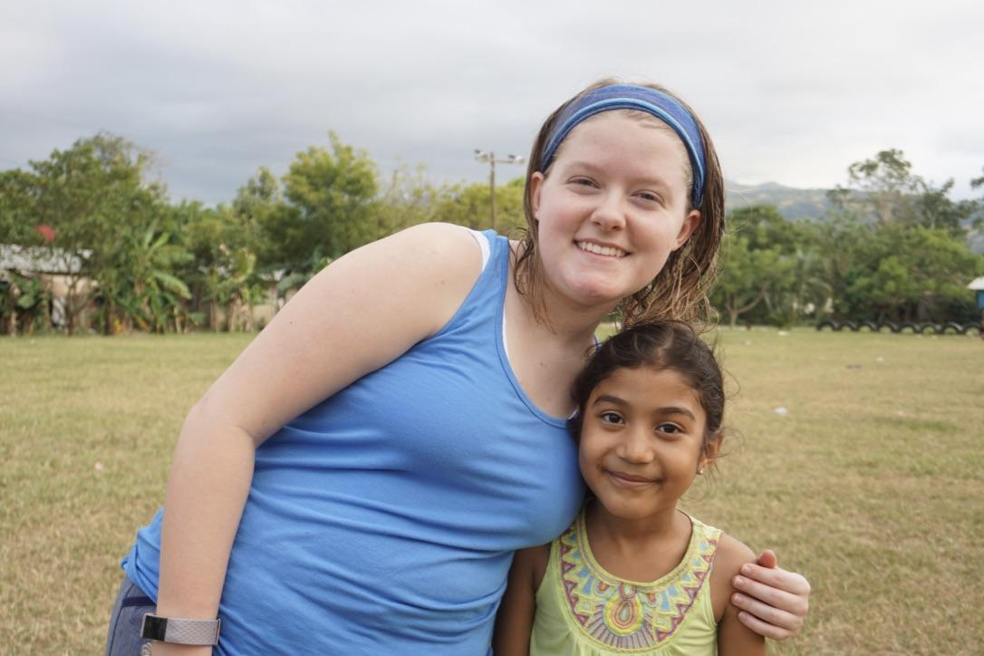
Villa Soleada

Slide 10
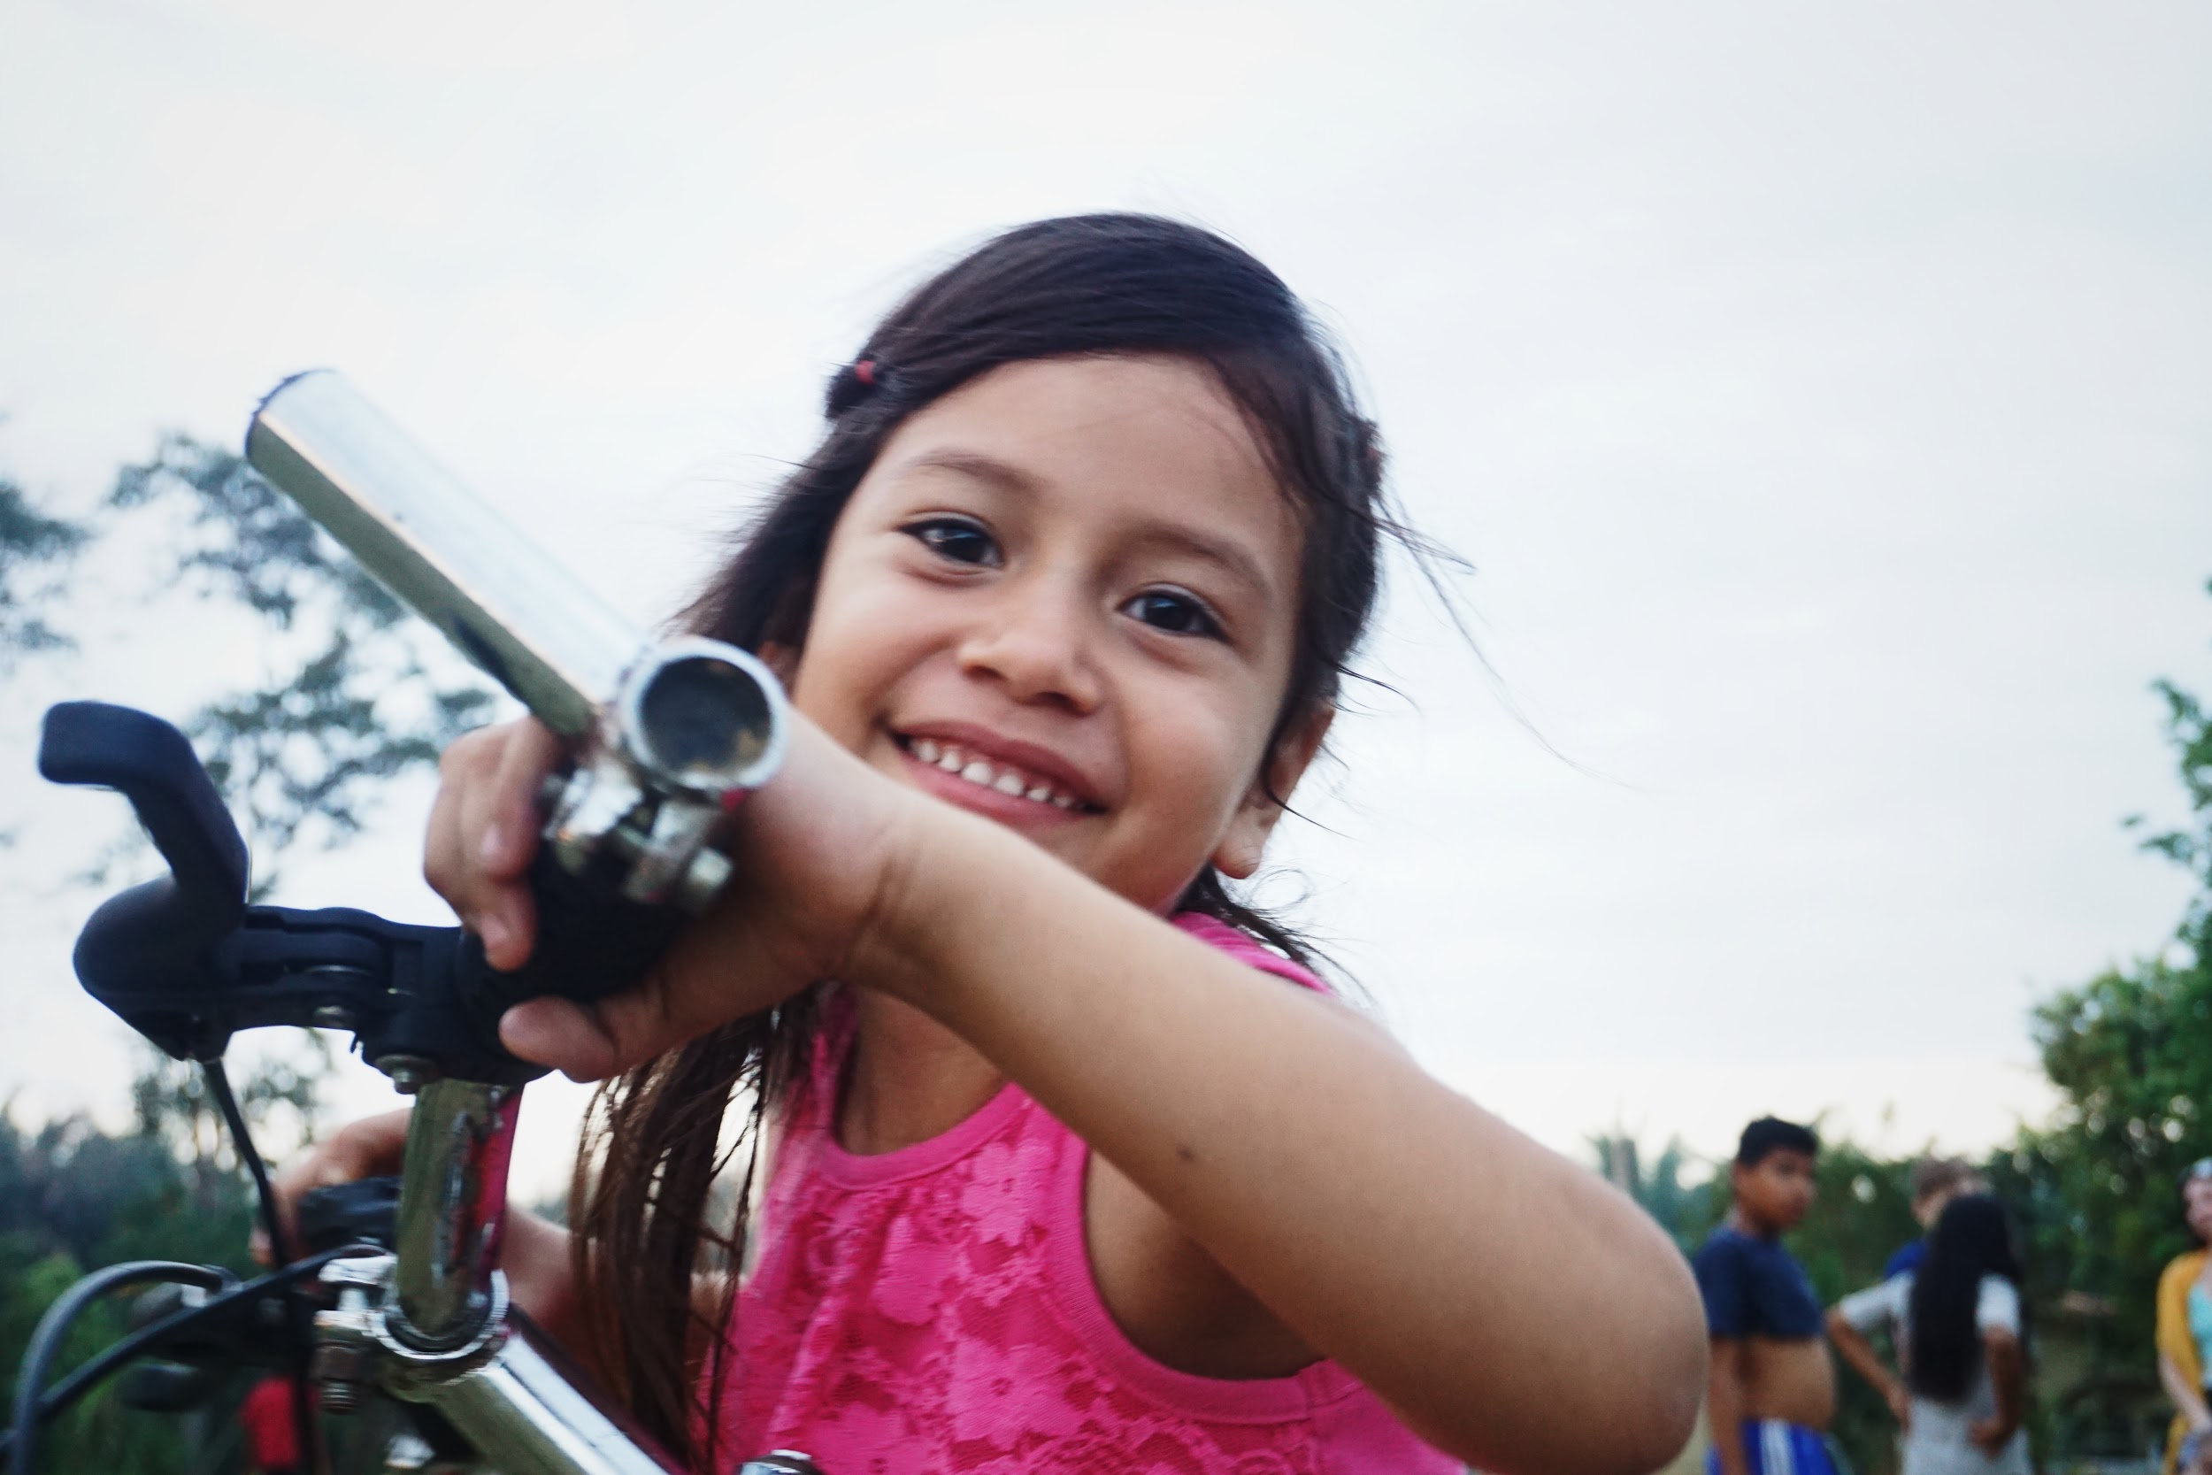
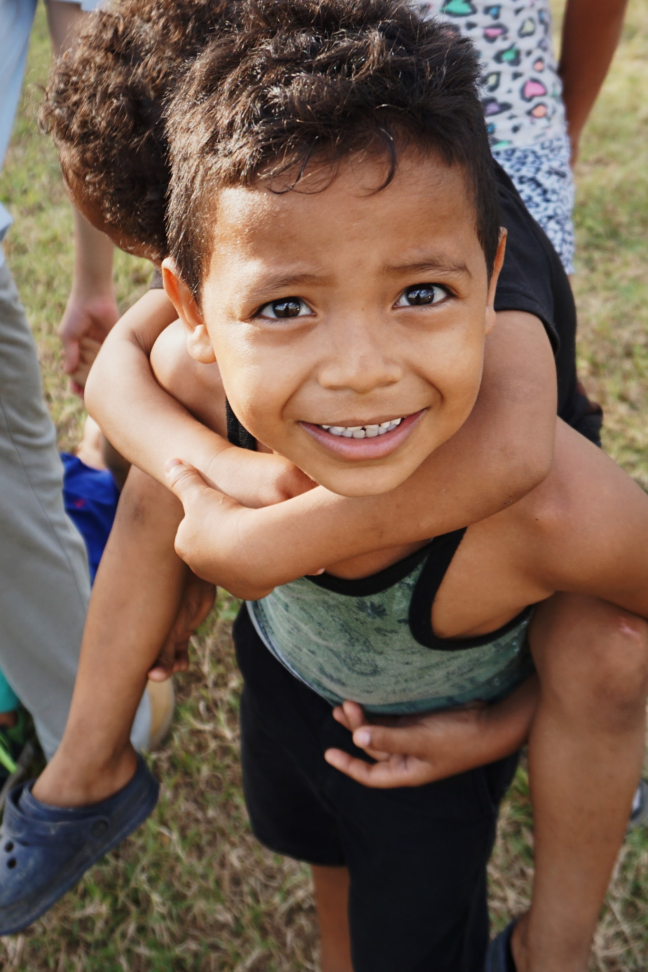
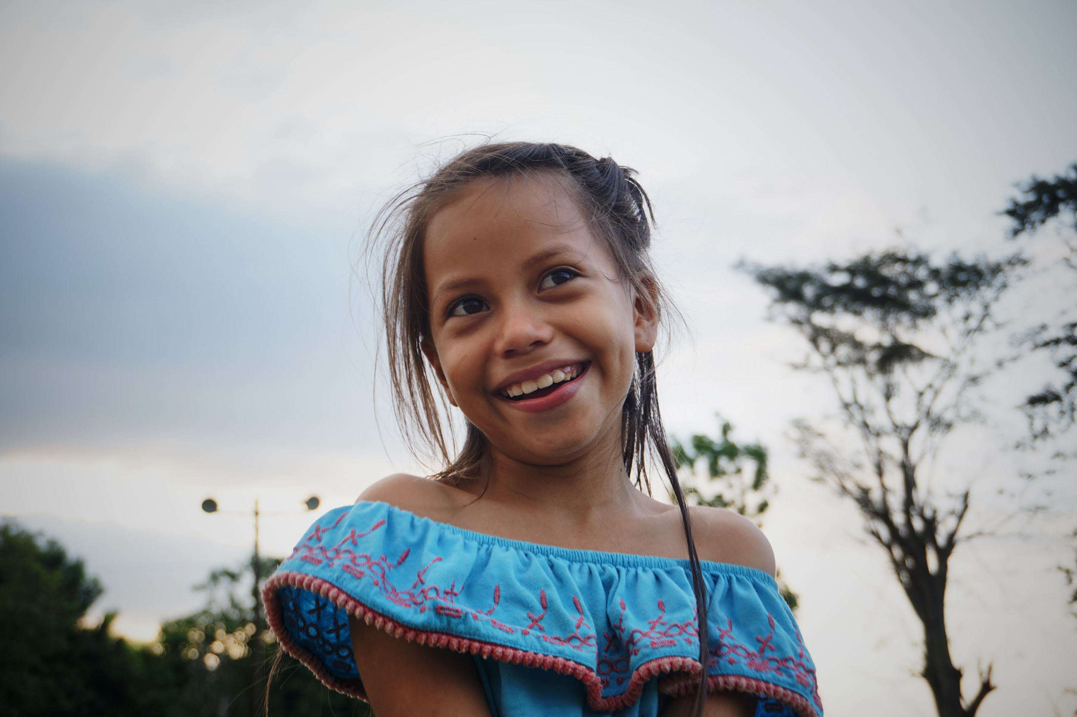
Photos

Slide 11
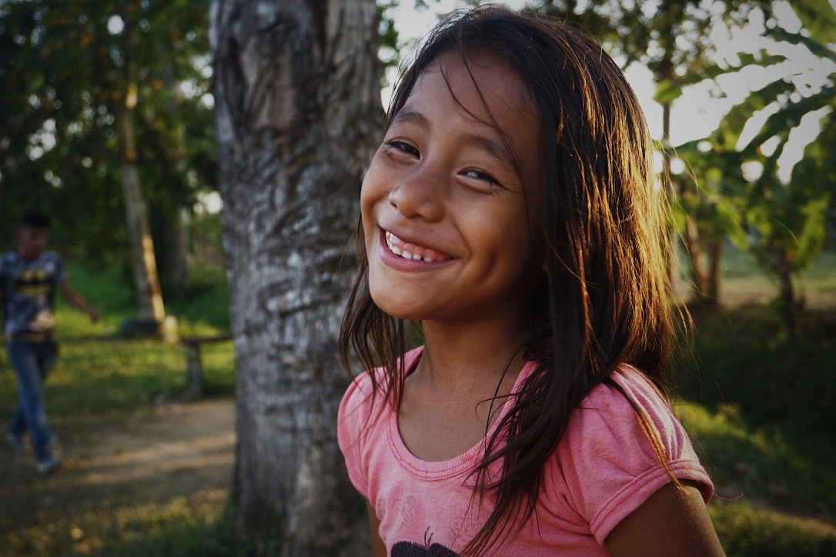
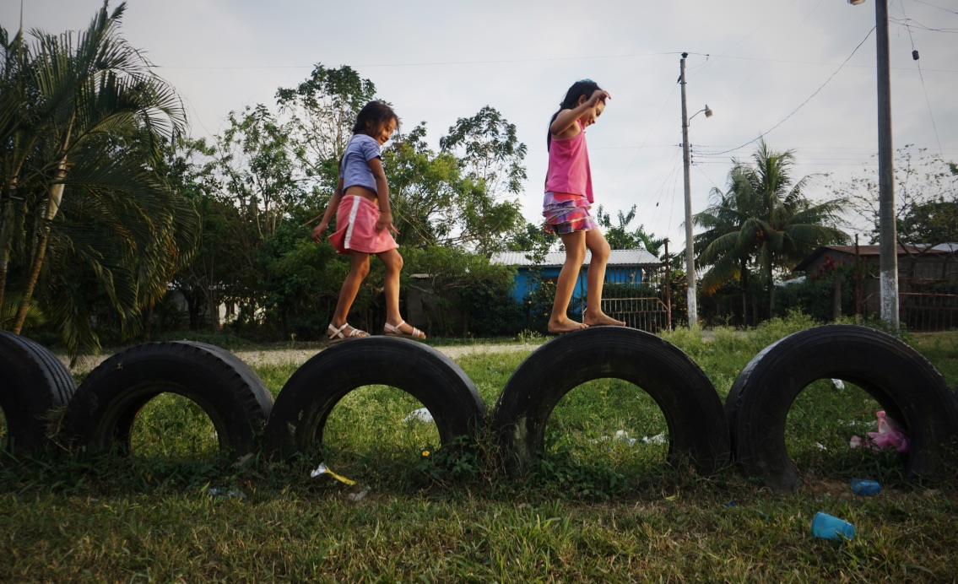
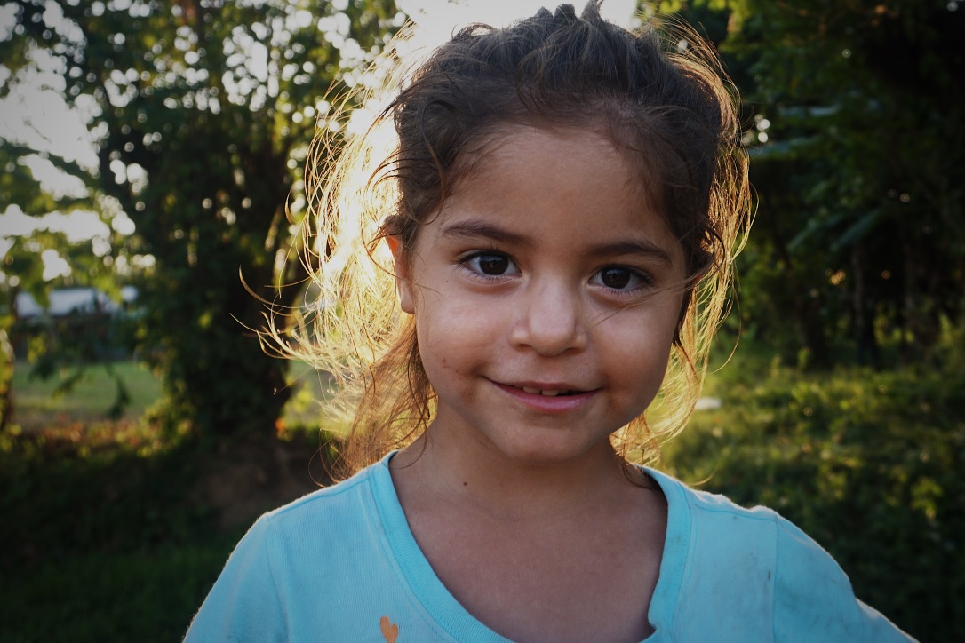
More Photos

Slide 12
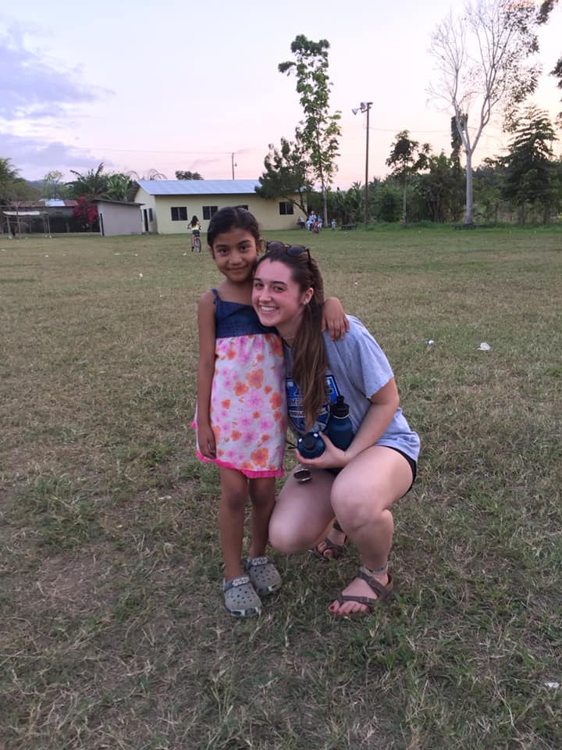
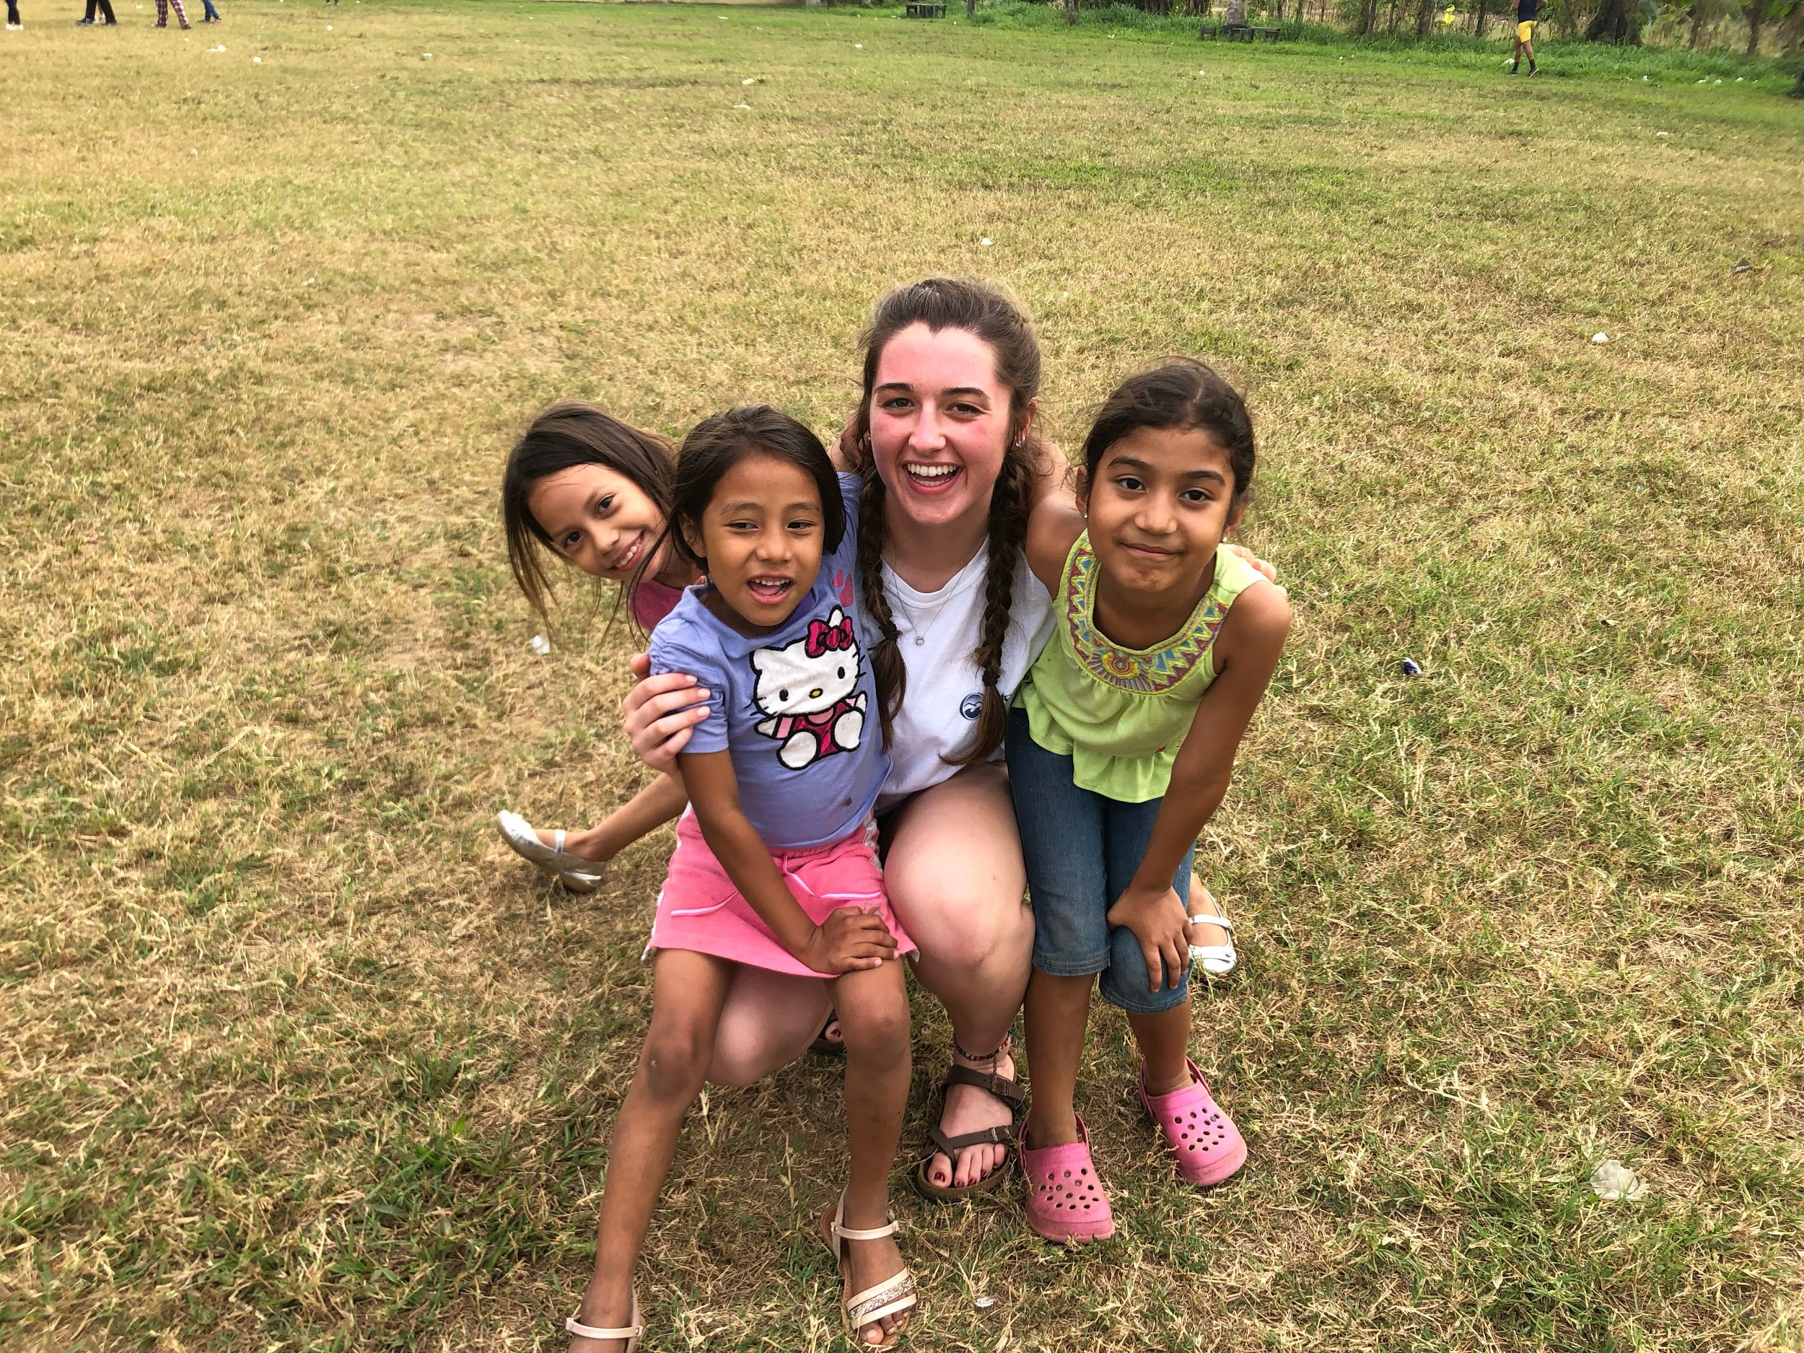
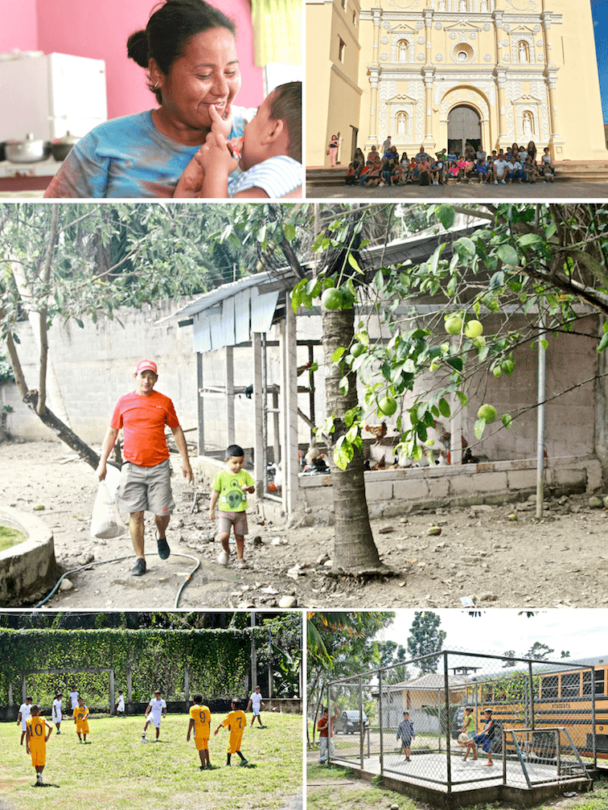
Sarah: Children’s Homes in Honduras and at Villa Soleada

Slide 13
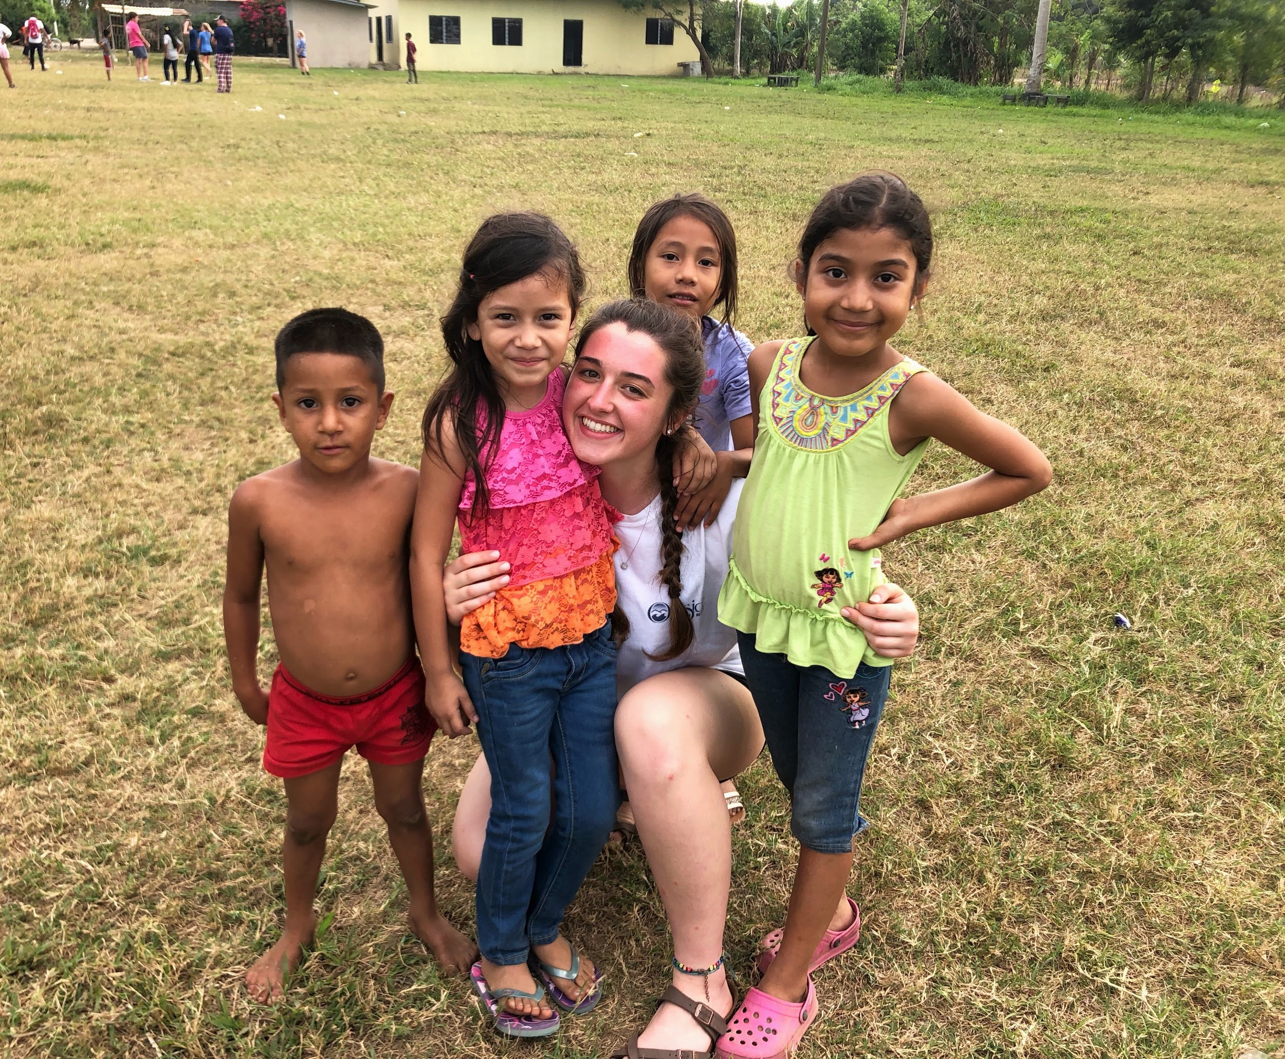
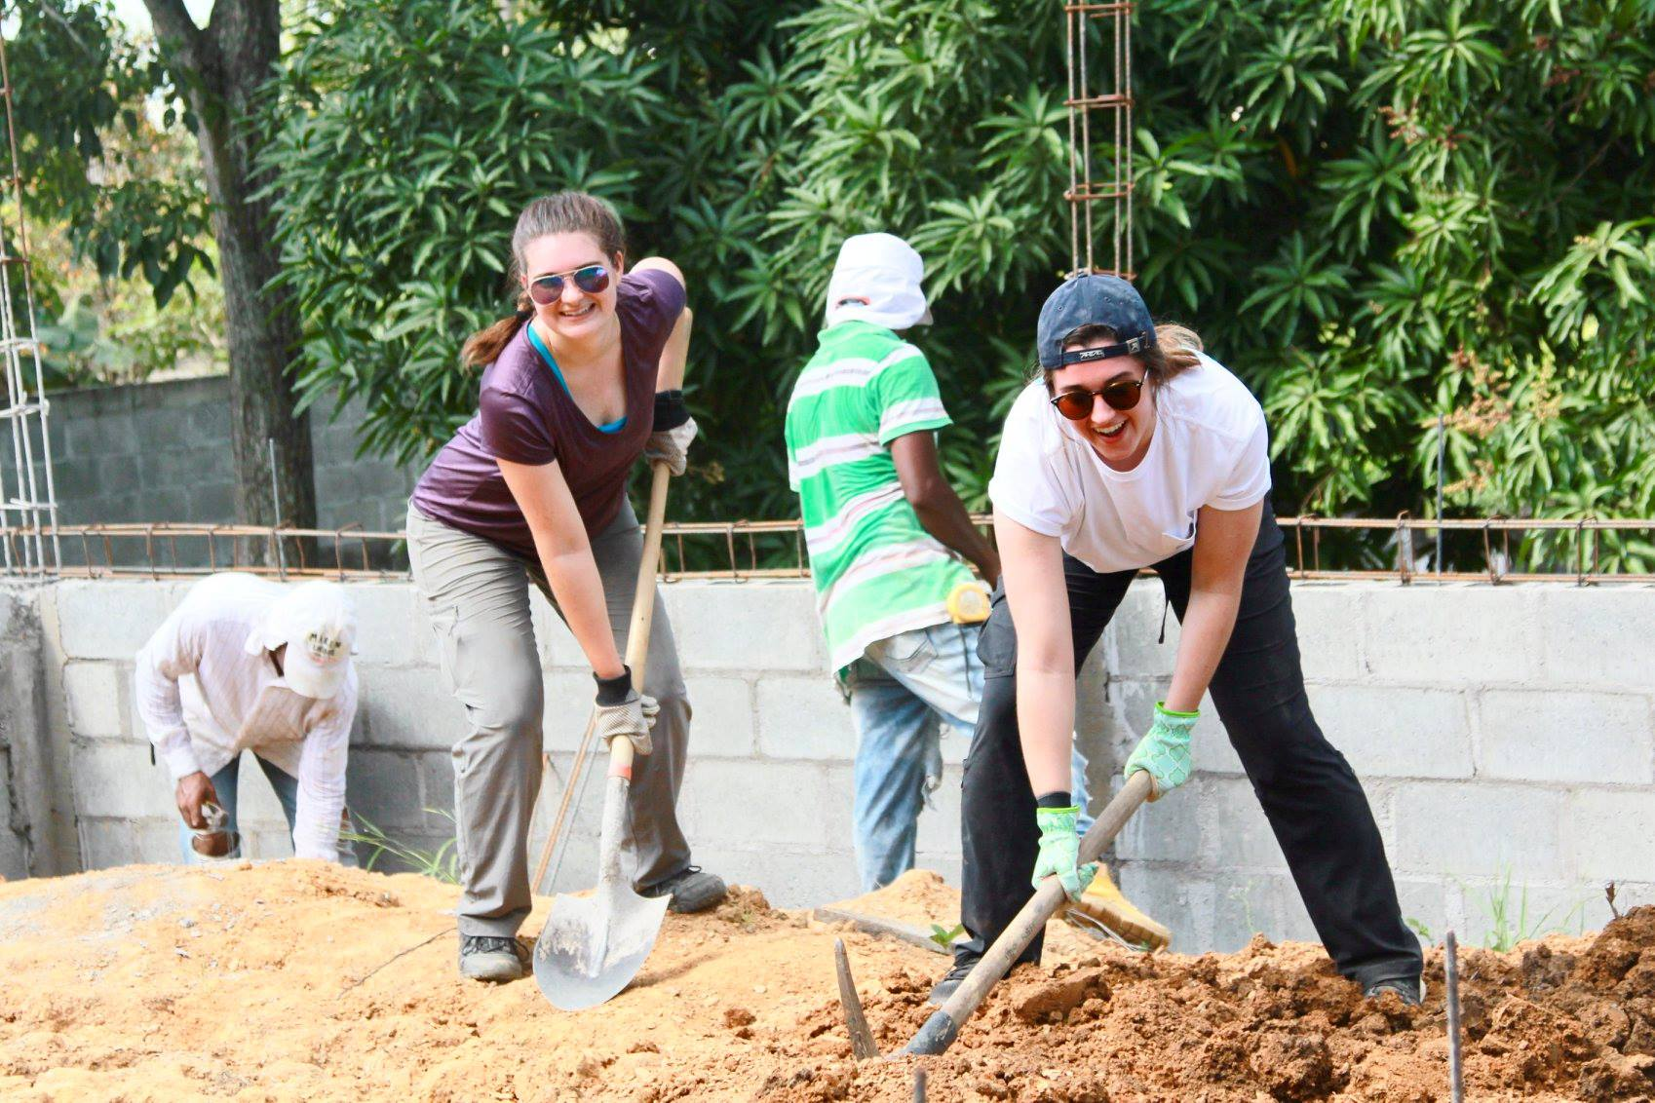

Slide 14
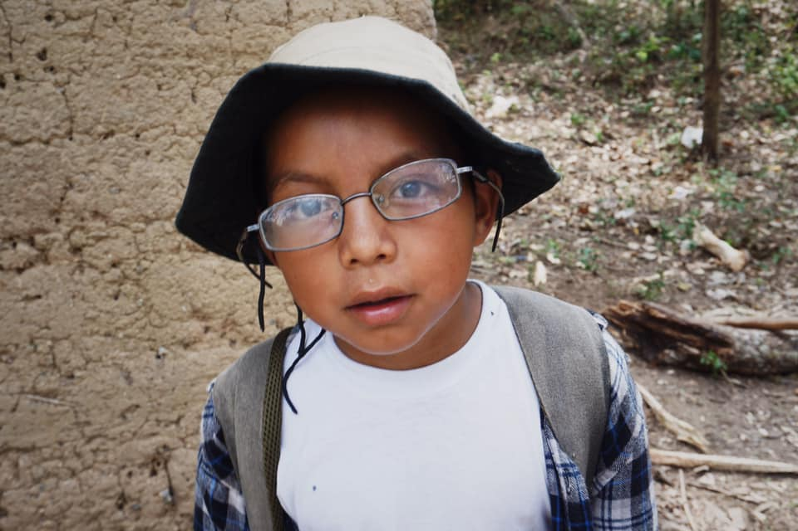
Giselle and Lily:
Isaias and the walk to his school/our worksite Marco Aurelio Soto
Video: https://drive.google.com/file/d/17HZ04b-32bR7c4FNxZfCq2U48WWmYLg4/view?ts=5c8a7b76

Slide 15
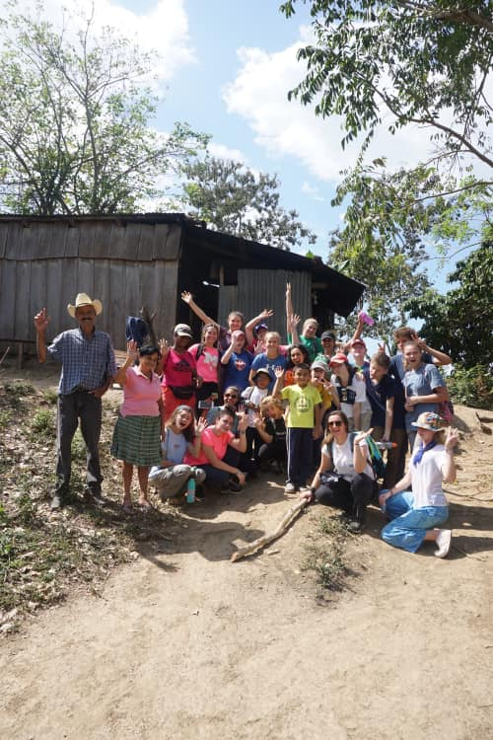
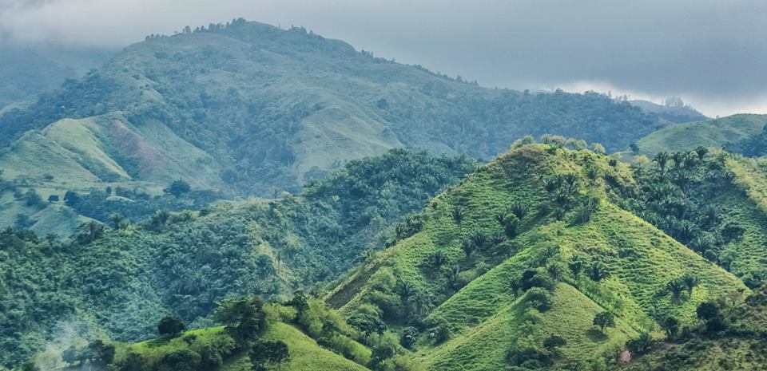

Slide 16
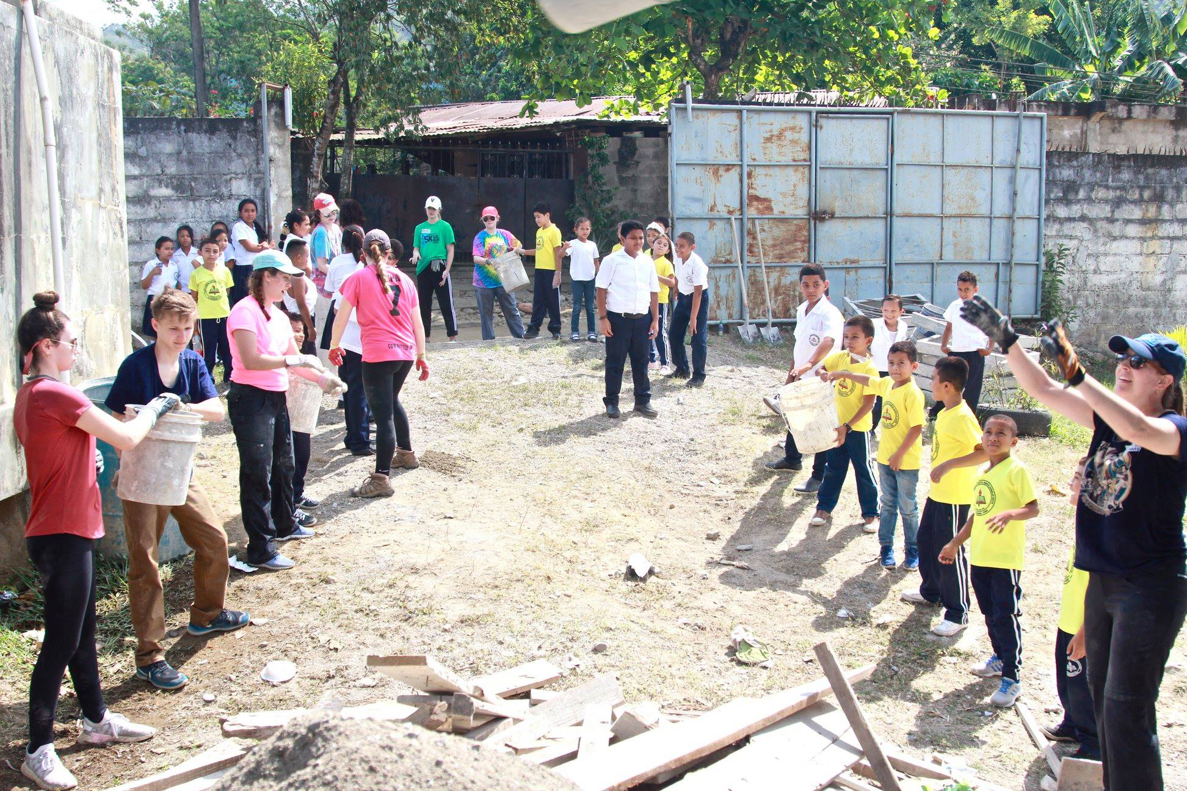
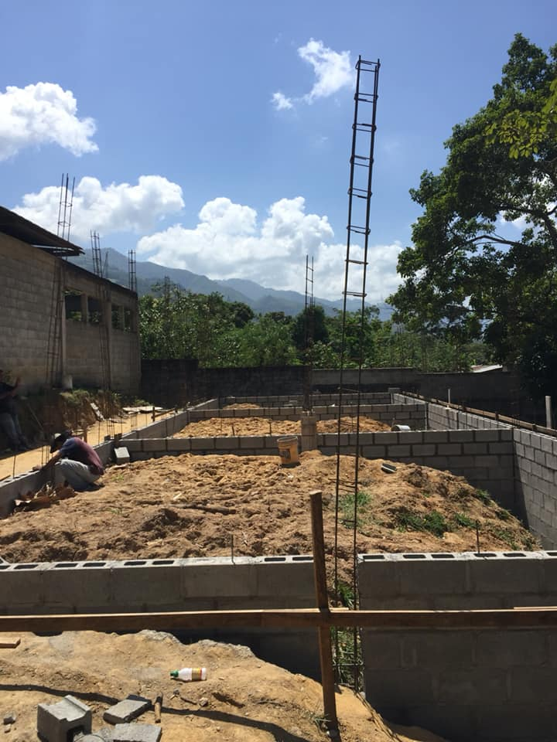
Jake: Construction projects at Marco Aurelio Soto

Slide 17
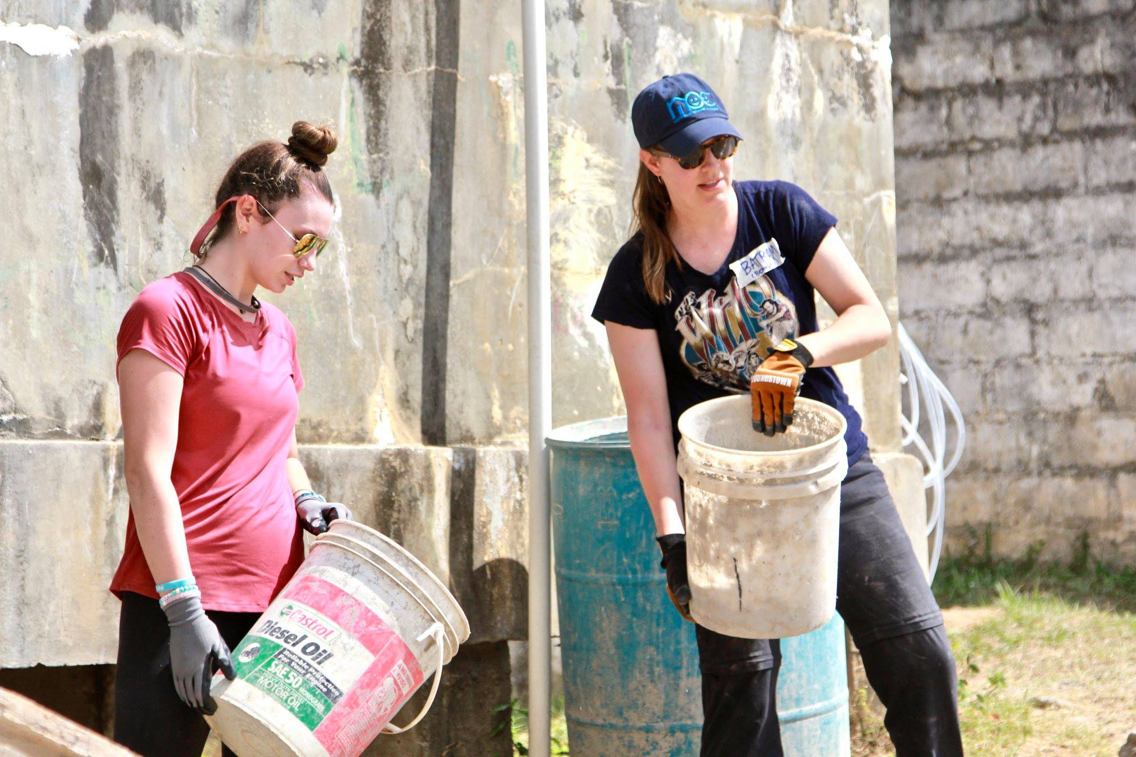
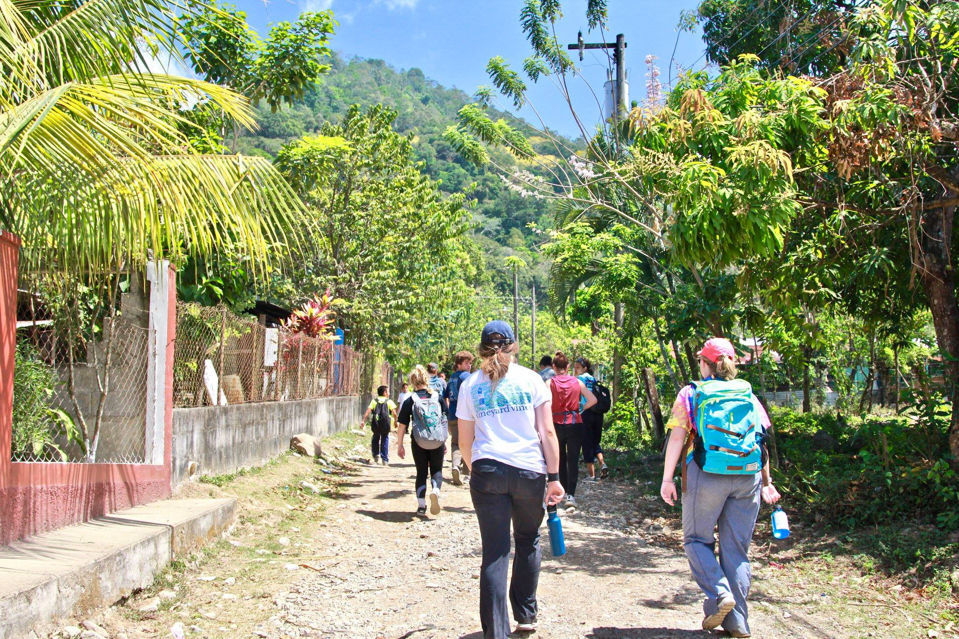

Slide 18
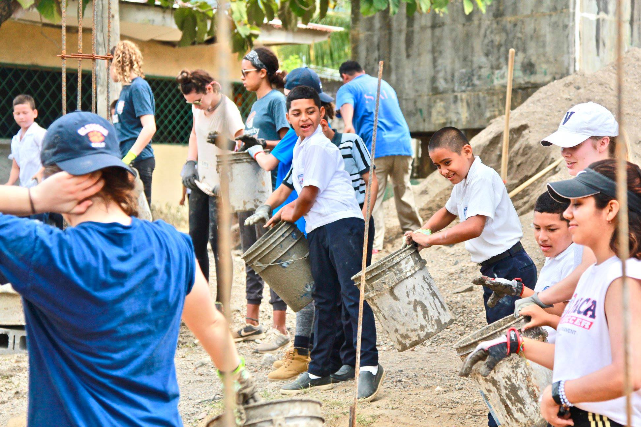

Slide 19
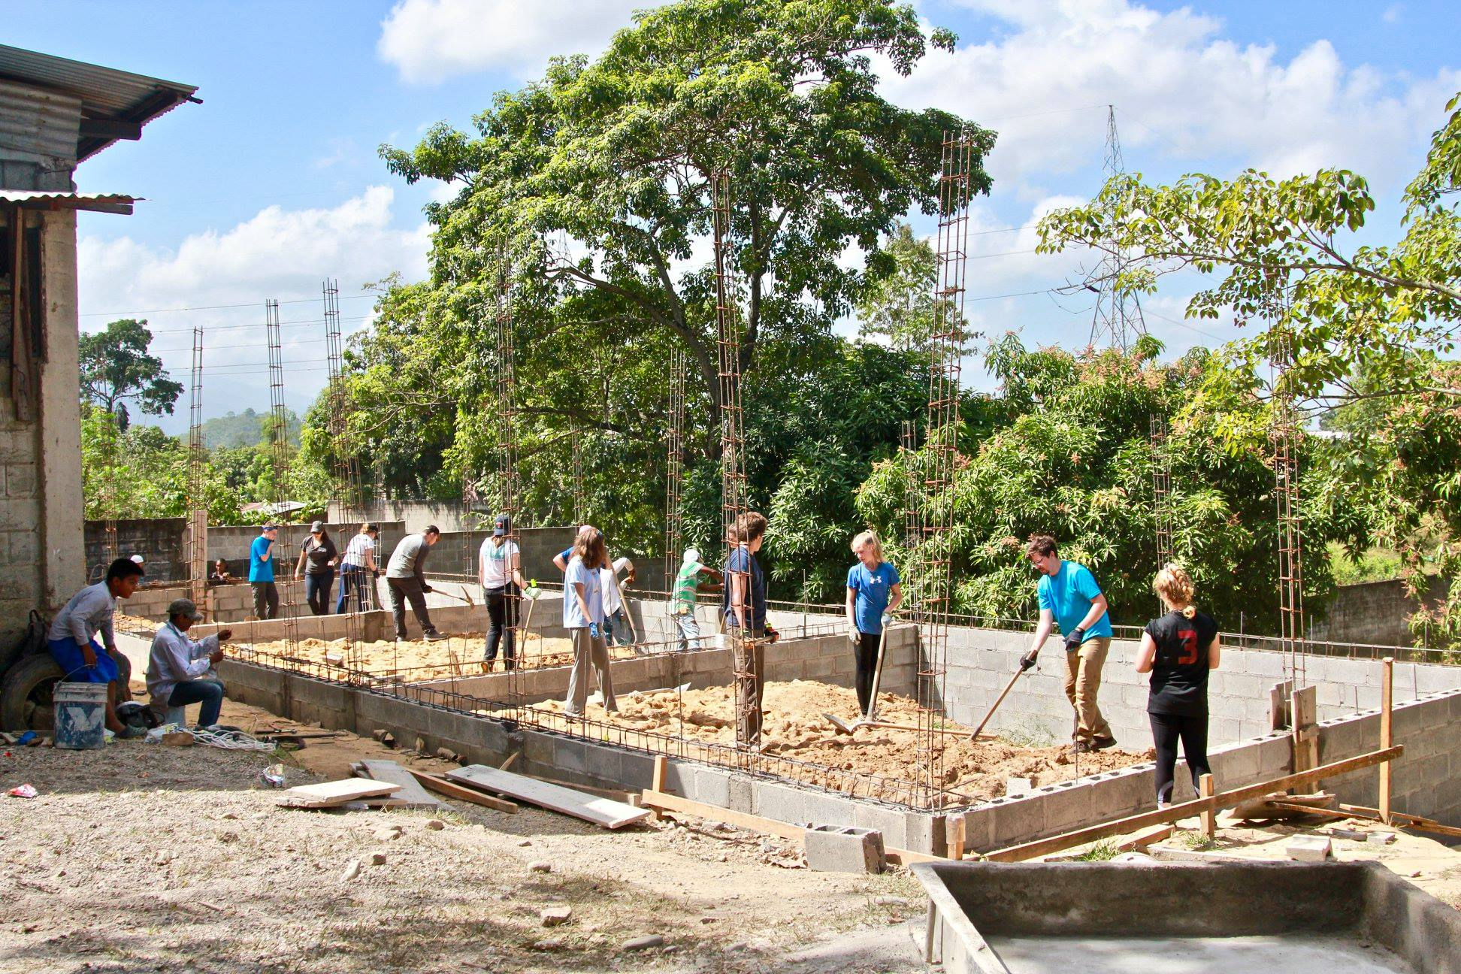
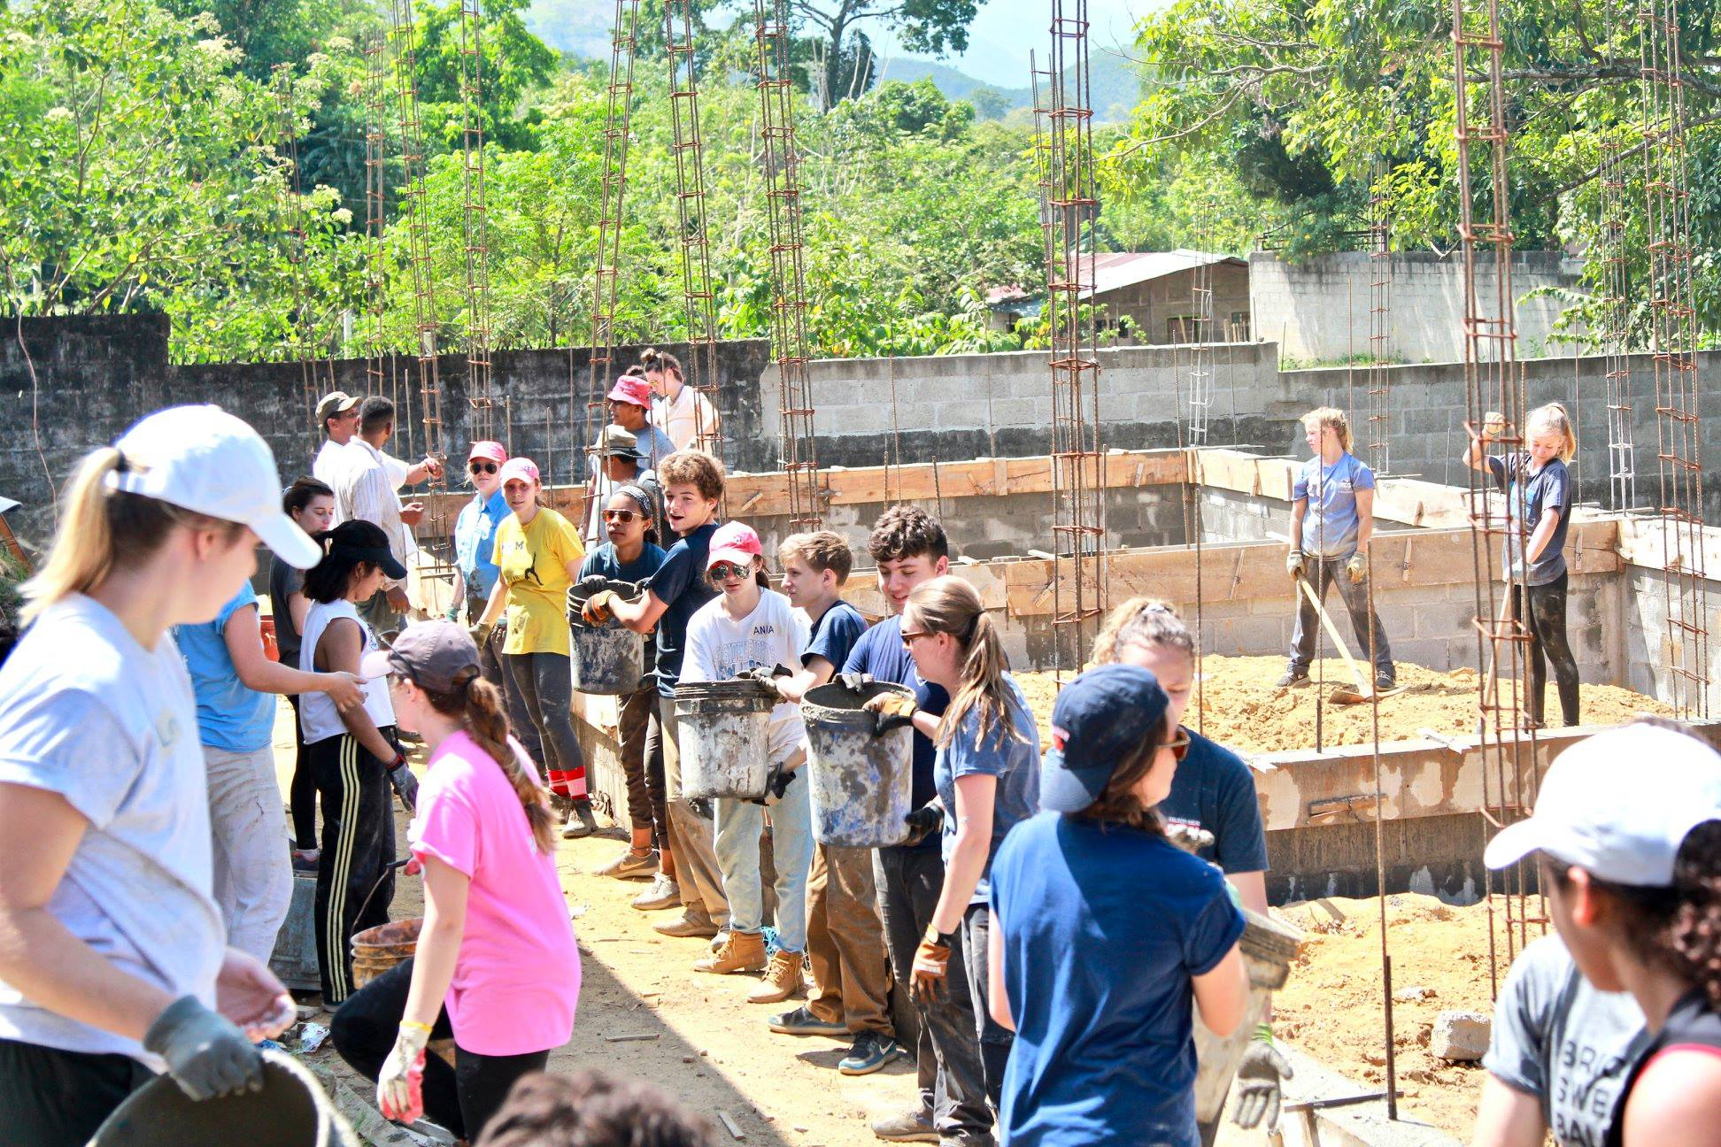

Slide 20
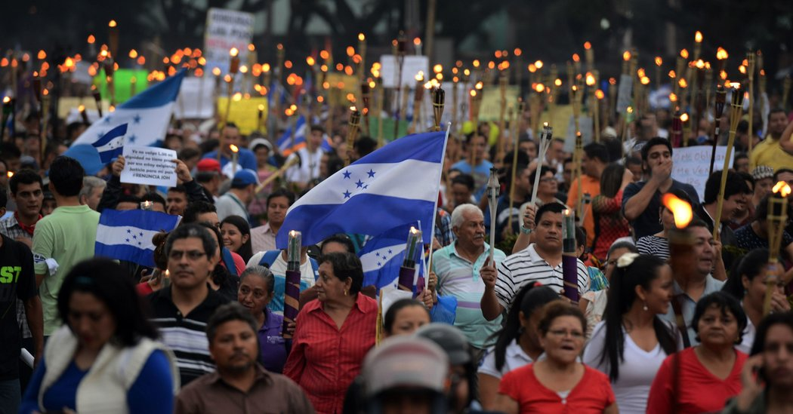
Connor: Corruption in Honduras

Slide 21
● The corruption of the government of Honduras is high
● Many gangs bribe the police and other officials
● There is a 95% impunity rate
● The Honduran President’s brother is in jail in the U.S. on drug charges
● The widespread corruption is one of the major things that is holding Honduras as a country back

Slide 22
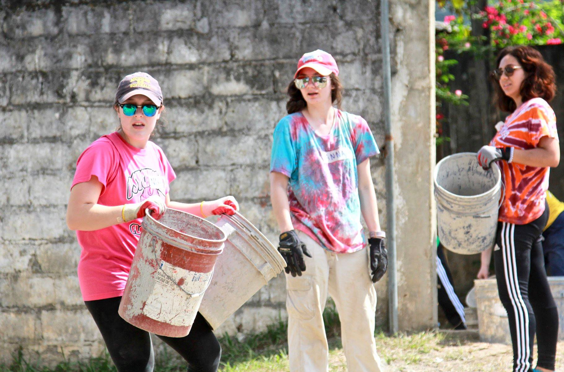
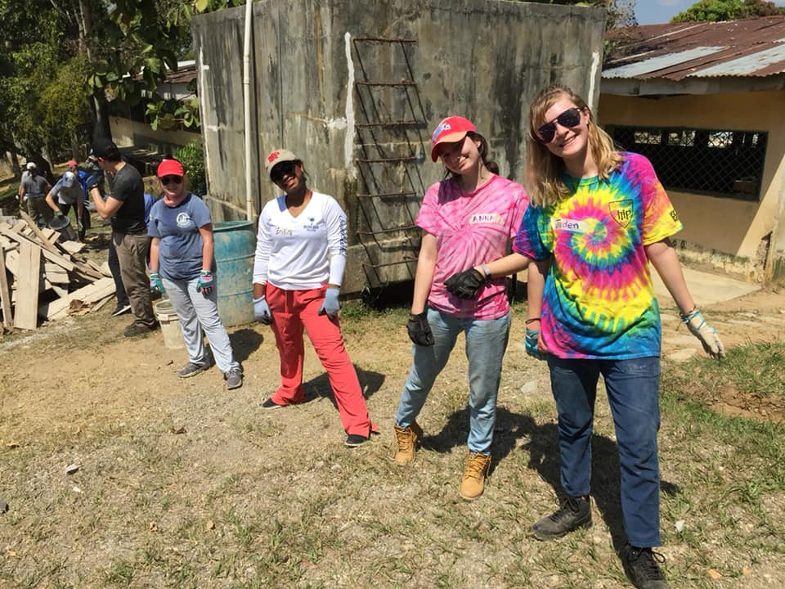
Anna and Jaden: service learning definition

Slide 23
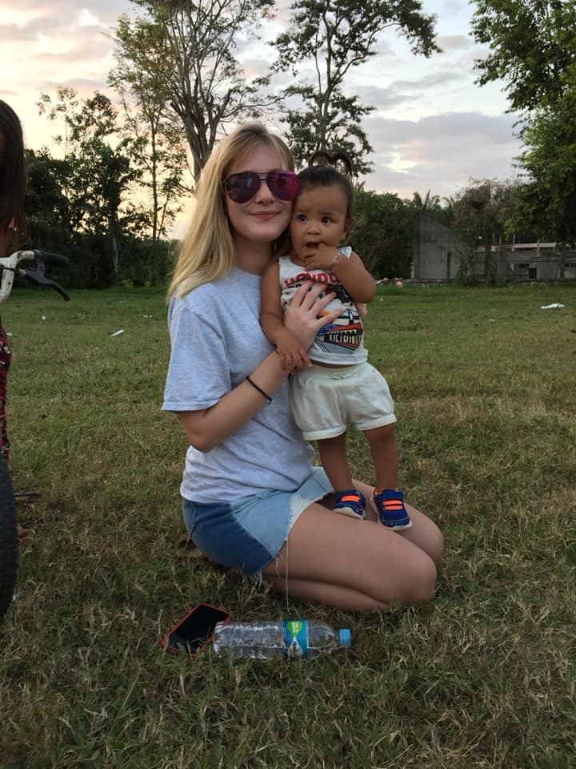
"The aim of service-learning is to enable students to see their actions in the larger context of social justice and social change… to empower individuals to bring about effective social, economic, and political change.” - David Busch

Slide 24
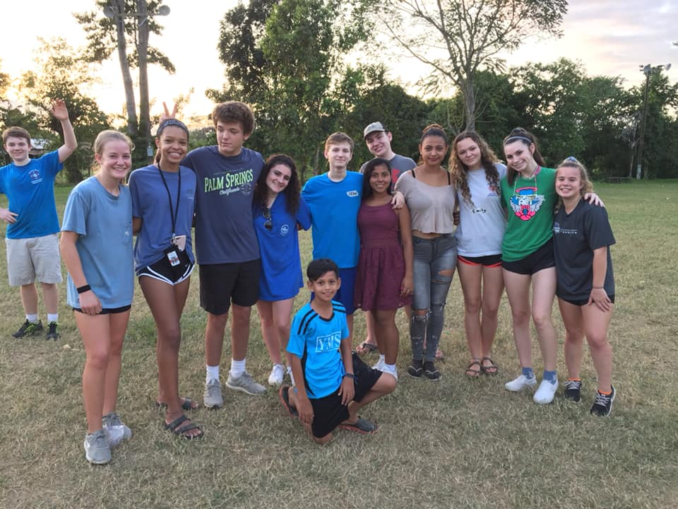
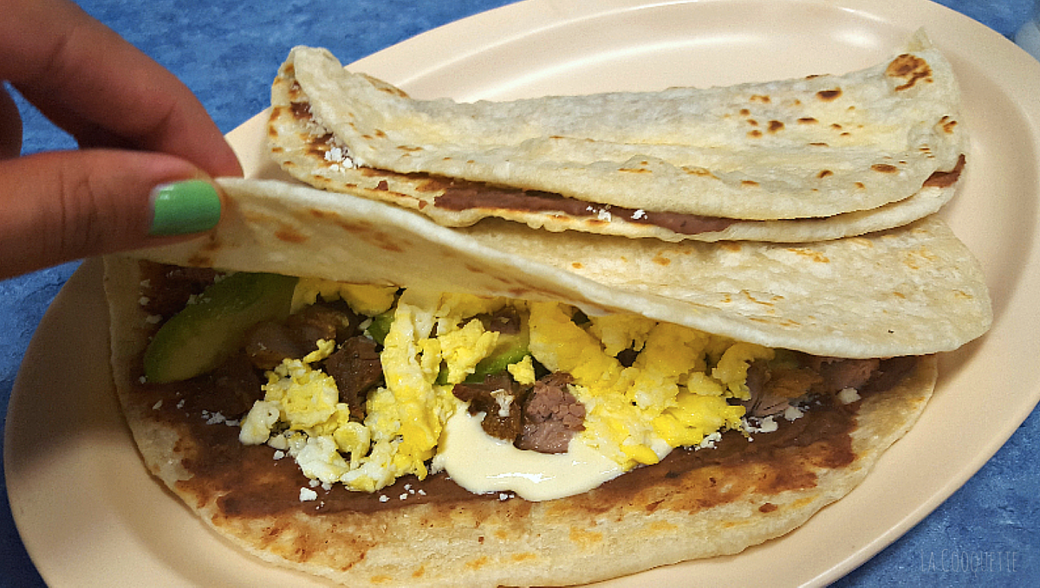
Emily and Lauren: Making Baleadas, the national food of Honduras

Slide 25
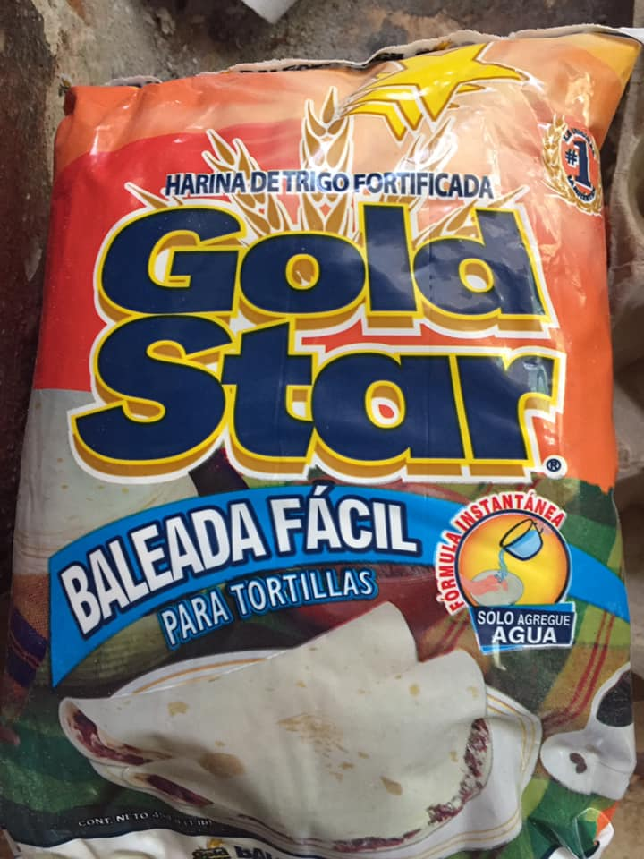
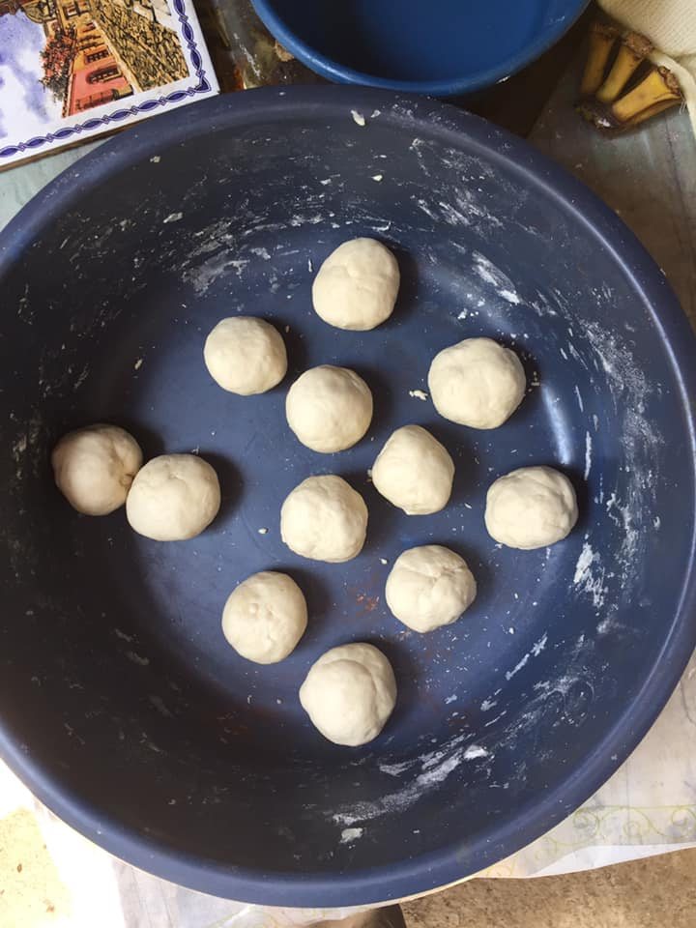

Slide 26
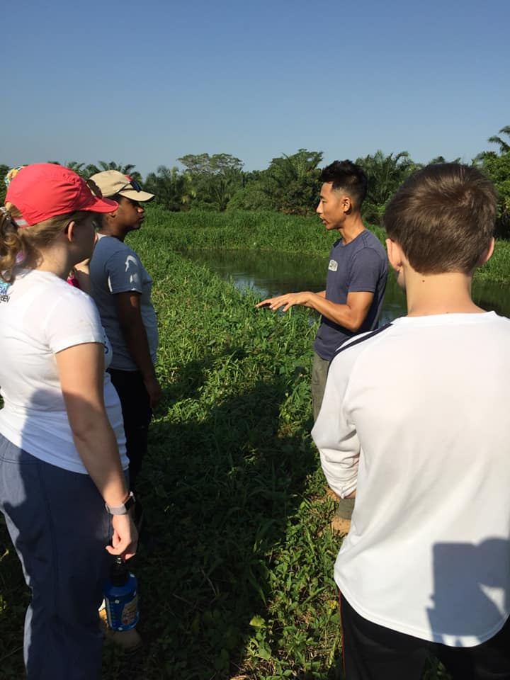
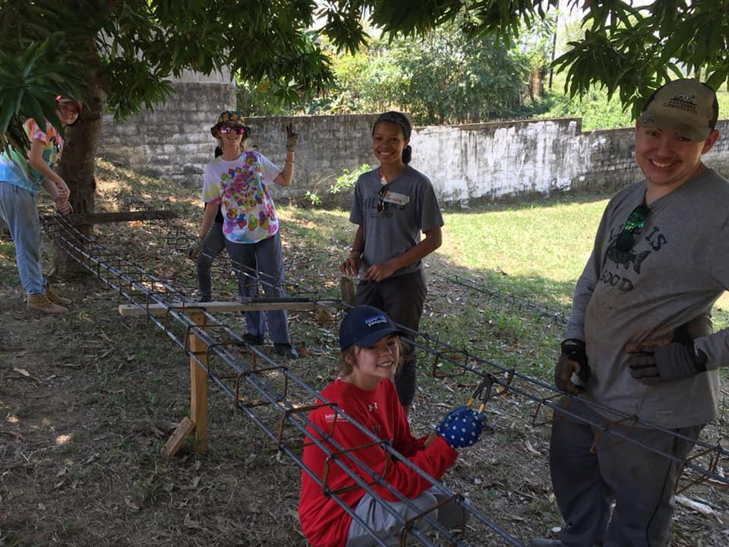
Scout: How to Get Involved

Slide 27
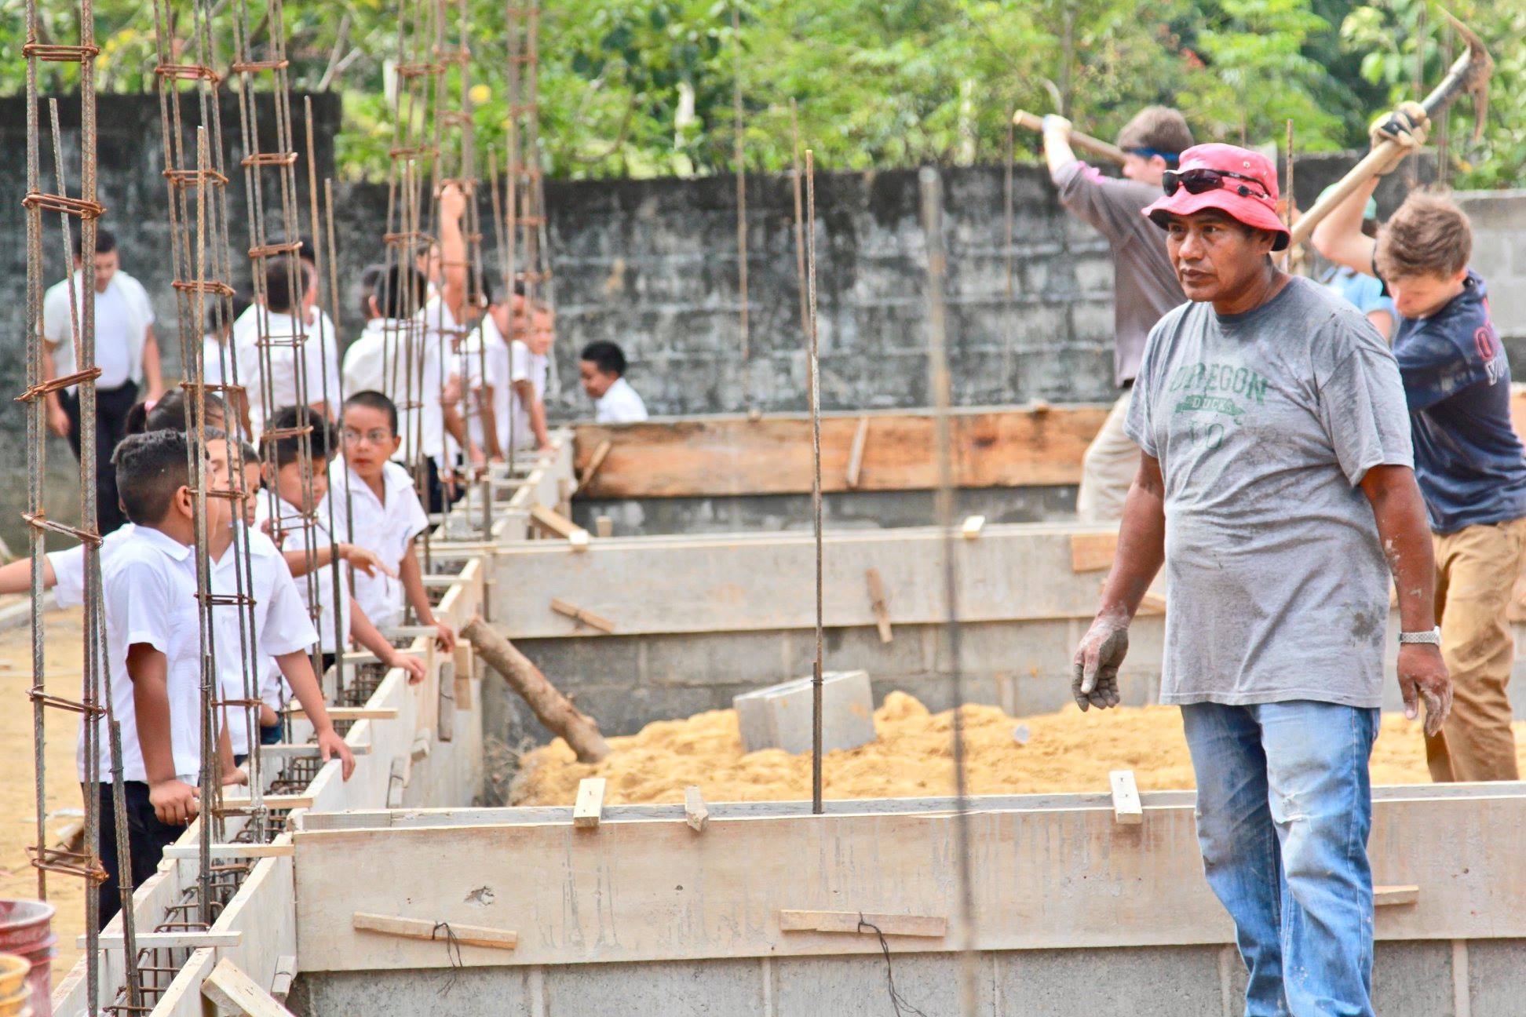

Slide 28
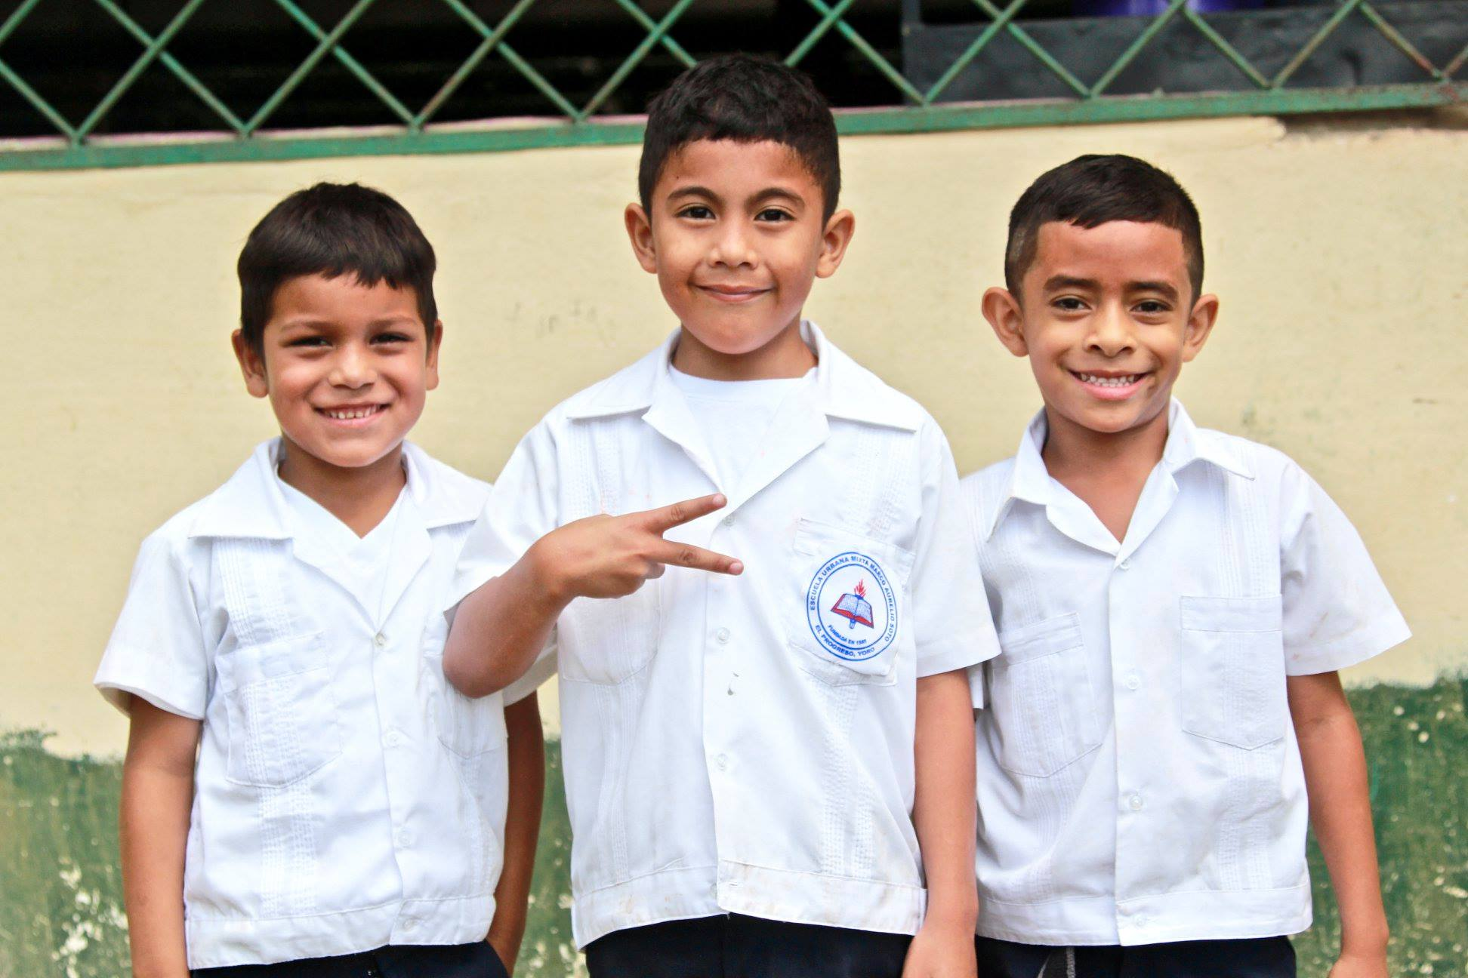

Slide 29
G-Ram: Closing and Special Recognition
Photography thanks to Susan Brooks, Jenny Jun, and others

Slide 30
Students Helping Honduras: www.shhkids.org

